Slide 1
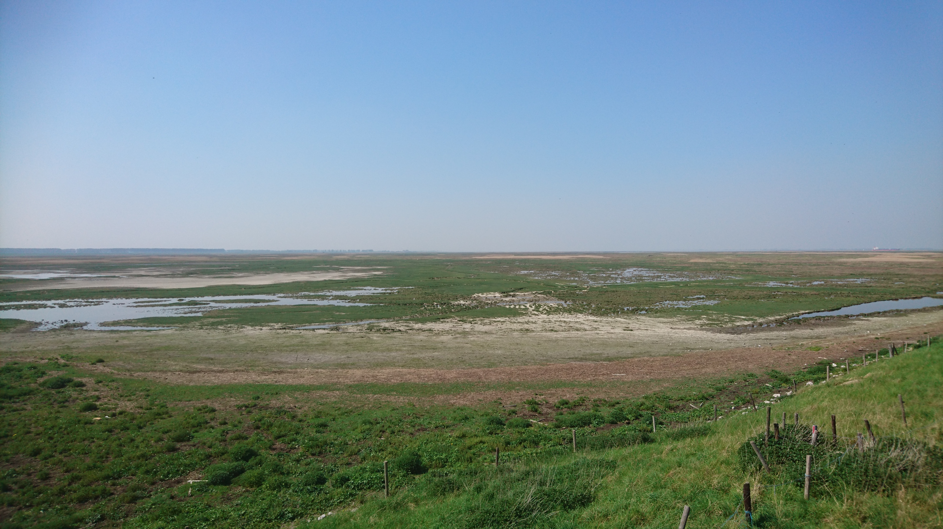
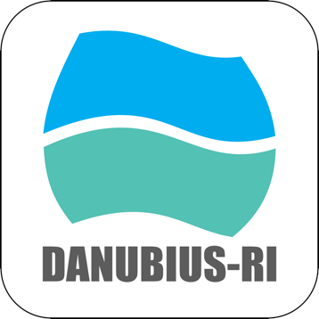
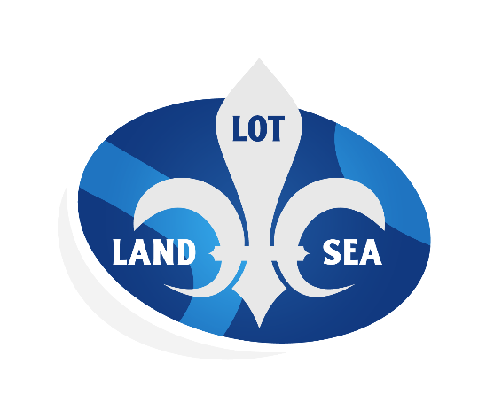
Practical experiences: from engaging NL in DANUBIUS-RI to co-creation with RIs in LandSeaLot
Jos Brils LandSeaLot coordinator and DANUBIUS-RI contact NL
Deltares
jos.brils@deltares.nl
Image (Jos Brils): Biogeomorphology at the Scheldt estuary (DANUBIUS Supersite)

Slide 2

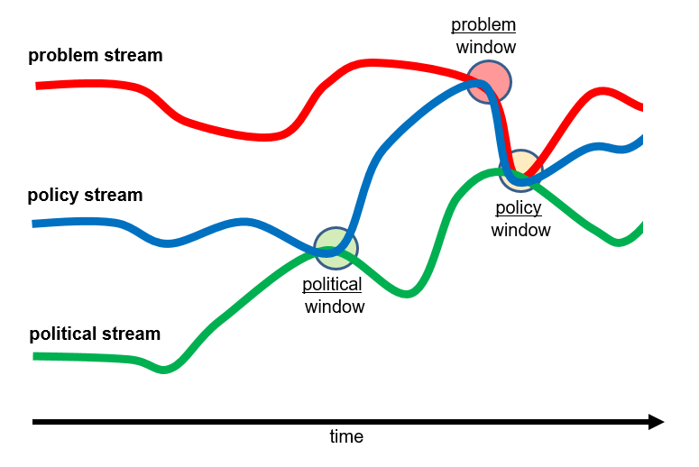
Kingdon’s Windows of Opportunity
“We conceive of three process streams flowing through the system – streams of problems, policies and politics.
They are largely independent of one another, and each develops according to its own dynamics and rules.”
“But at some critical junctures the three streams are joined, and the greatest policy changes grow out of that coupling of problems, policy proposals, and politics”
* Kingdon JW (1995) Agendas, alternatives, and public policies. New York, Longman

Slide 3
Dutch perspective on the Windows of Opportunity for DANUBIUS-RI
D on ESFRI road-map
D-NL at national roadmap RIs
Deltares
joins
D-IIC
Start build D-NL
D-NL (ENIGMA) granted
ERIC granted
2012
2013
2014
2015
2016
2017
2018
2019
2020
2021
2022
2023
2024
2025
1st
problem window
2nd
problem window
3rd
problem window
problem stream (Scientists)
policy stream (Min I&W and EC DG R&I)
political stream (Minister I&W)
1st
policy
window
2012
2013
2014
2015
2016
2017
2018
2019
2020
2021
2022
2023
2024
2025
D = DANUBIUS IIC = International Initiative Committee
Min = Ministry
I&W = Infrastructure and Water Management
R&I = Research and Innovation LoS = Letter of of Support BGR = Board of Governmental Representatives
1st contact NL Ministries
Min I&W ESFRI LoS
Min I&W joins D-BGR
NL Minister ERIC letter

Slide 4
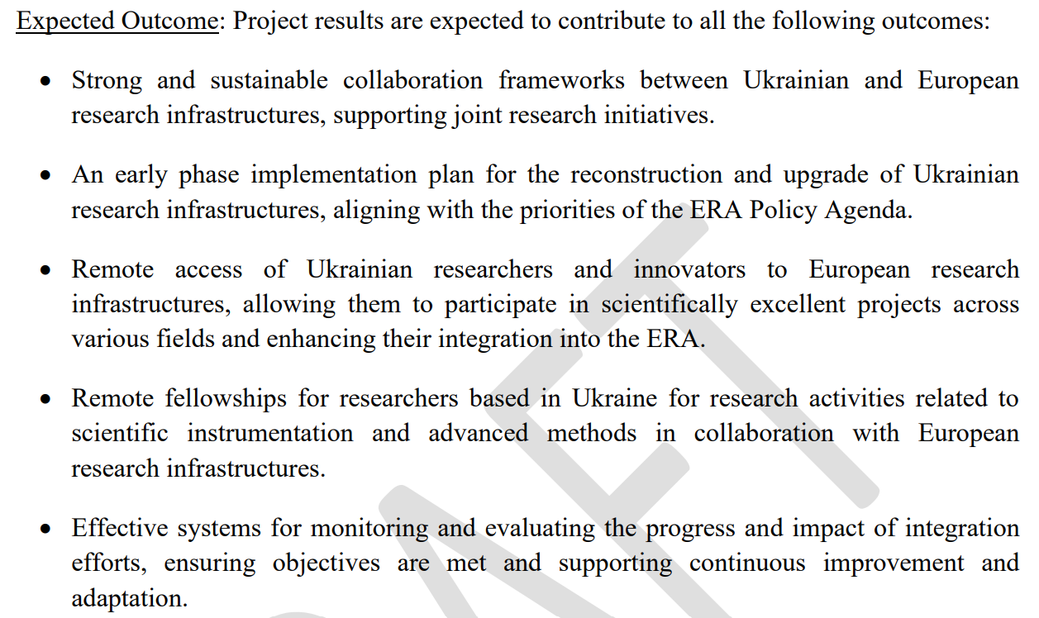
RI Window of Opportunity for Ukraine?

Slide 5
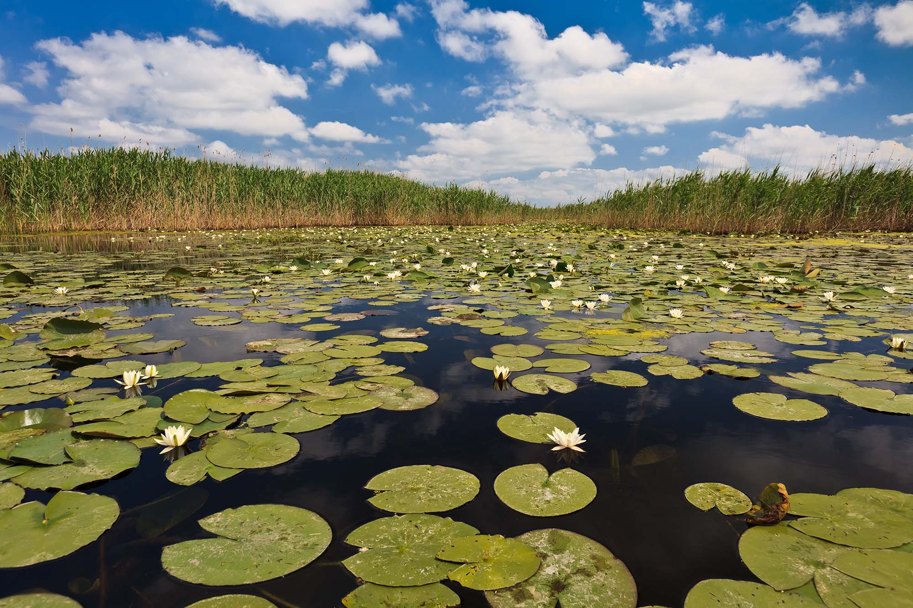
Our Vision
Achieve healthy River-Sea Systems and to advance their sustainable use, in order to live within the planet’s ecological limits by 2050.
Our Mission
provide state-of-the art research infrastructure from river source to sea;
facilitate excellent interdisciplinary science;
offer integrated knowledge to manage and protect River-Sea Systems.
Our Goals
overcome the current fragmentation of science, knowledge, data & management in rivers and seas by integrating spatial, temporal, disciplinary and sectorial thinking;
provide scientific solutions to environmental and societal risks from climate change;
resolve problems arising from human impacts on River-Sea Systems by using an interdisciplinary perspective, from source to sea.

Slide 6
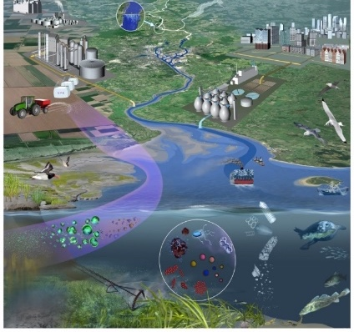

Interdisciplinary Science is needed:
Climate Change – felt through water
Extreme Events: Storms, floods and droughts
Climate change scenarios - worsening
Multiple pressures
Unfulfilled opportunity that require whole system understanding (Source- to-sink approach)
Net Zero & Green Recovery
Sediment Management and Biodiversity

Slide 7
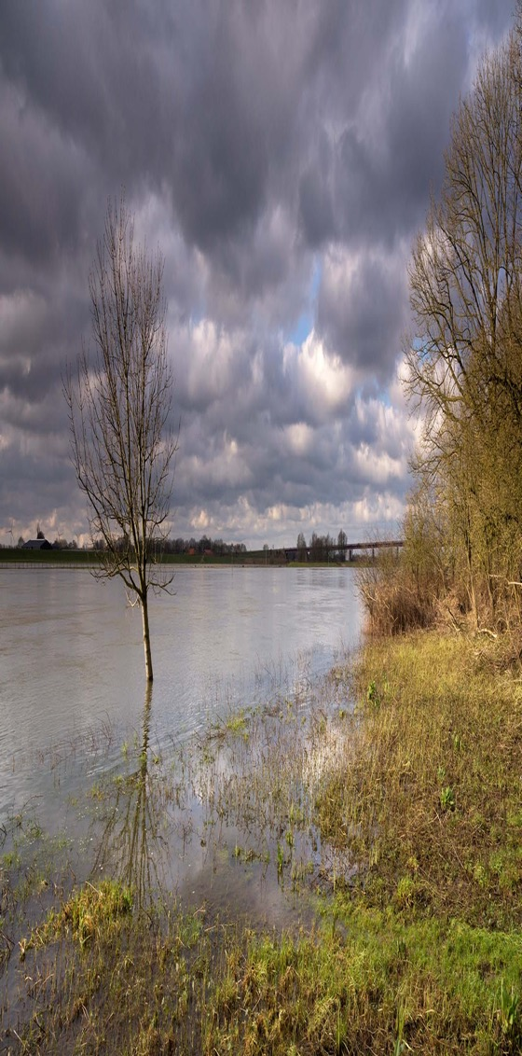
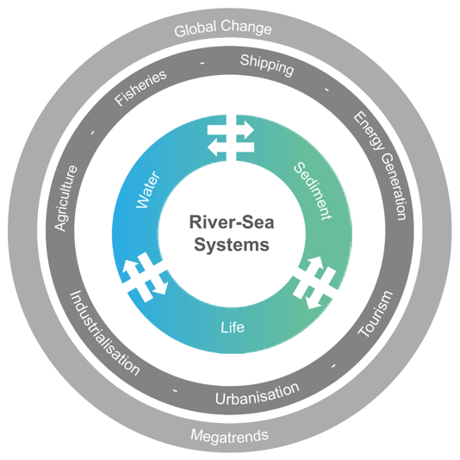
DANUBIUS-RI Research Areas and Priorities (updated SRIA to 2027)
Image: Flooding in The Rhine
Water and Sediment
RP1 Water Quantity;
RP2 Sediment Balance;
RP3 Nutrients and Pollutants;
Global Change & Megatrends
RP4 Climate Change;
RP5 Extreme Events;
Biodiversity and Ecosystems
RP6 Protecting and Restoring Ecosystems and Biodiversity;
Multiple Impacts on River- Sea Systems
RP7 Digital Twin.

Slide 8

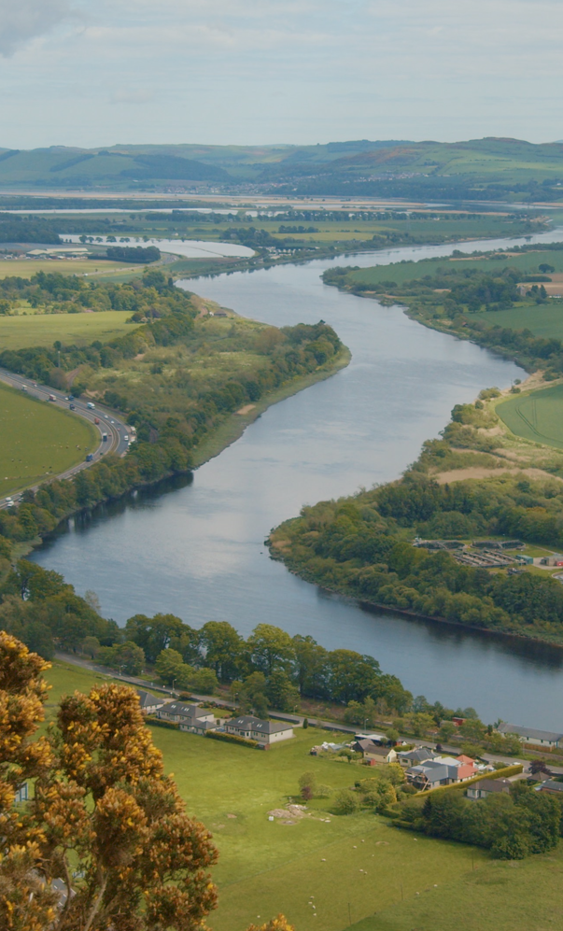
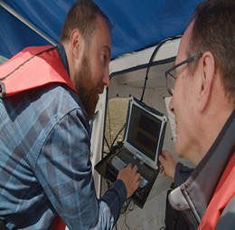
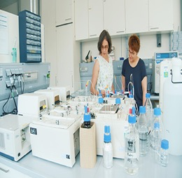
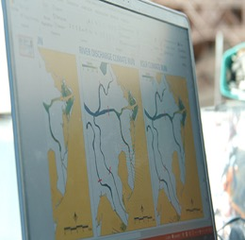
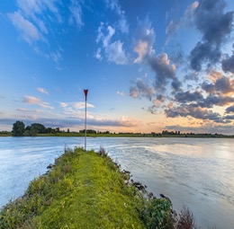
4 Nodes
Observation (UK)
Analysis (Romania)
Modelling (Italy)
Impact (Netherlands)
Real time observation tools and instruments, new sensors, satellites, automated data processing, quality control and visualization
Laboratories, instrumentation and highly innovative methodologies for samples analysis.
Development of new modelling tools in terms of new algorithm, data-models interaction, interfaces, link with socio-economic modelling.
Interface between natural and social sciences developing methodologies and tools that will help to solve problems in highly complex dynamic RS systems
Tay river

Slide 9
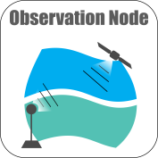
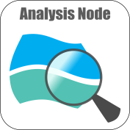
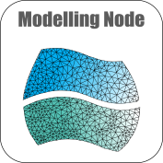
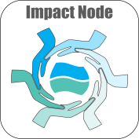
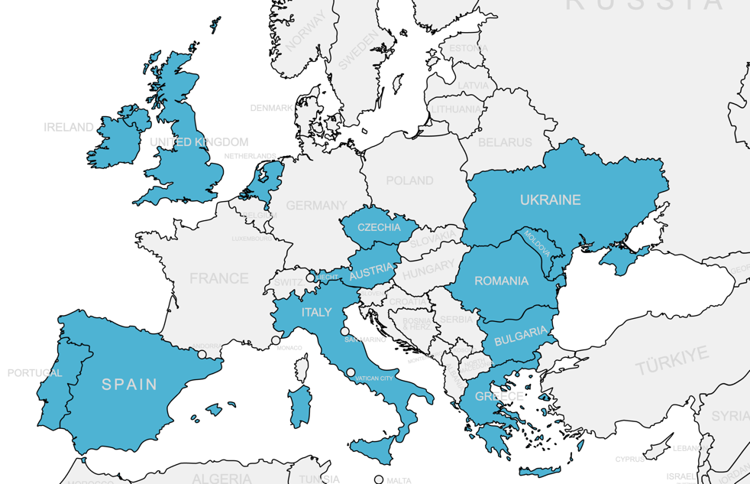
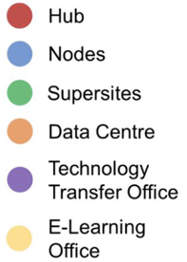
Entire DANUBIUS-RI architecture and Delta-ENIGMA: the DANUBIUS-NL contribution
4 Thematic Nodes
All Components
10 Supersites
DANUBIUS-NL / Delta-ENIGMA
New Supersite offers from IE, PT, RO, presented in Nov. 2023

Slide 10
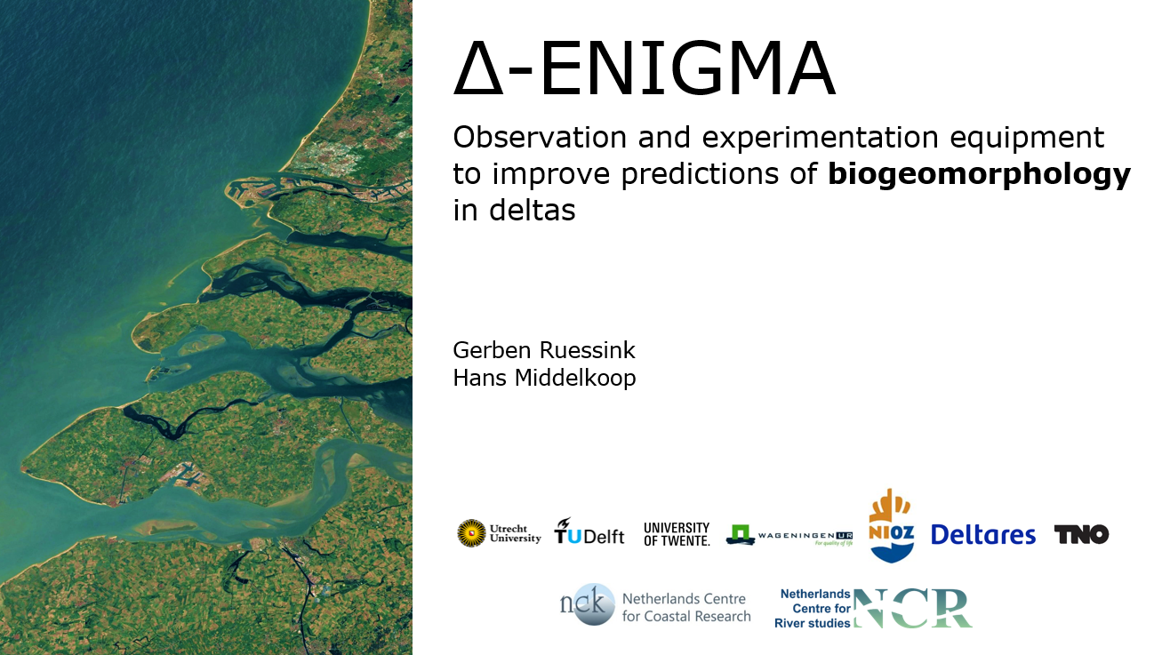
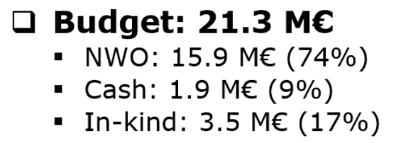

Slide 11
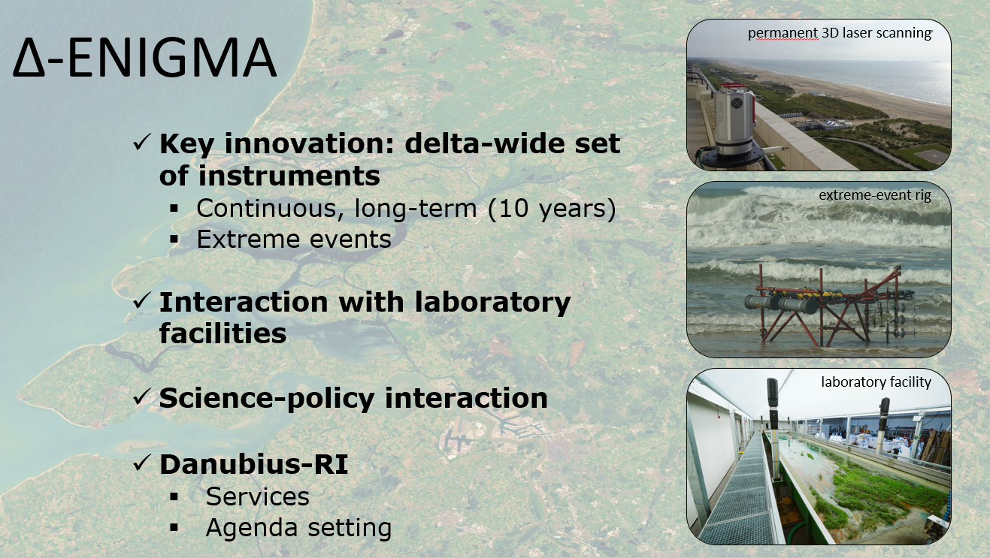

Slide 12
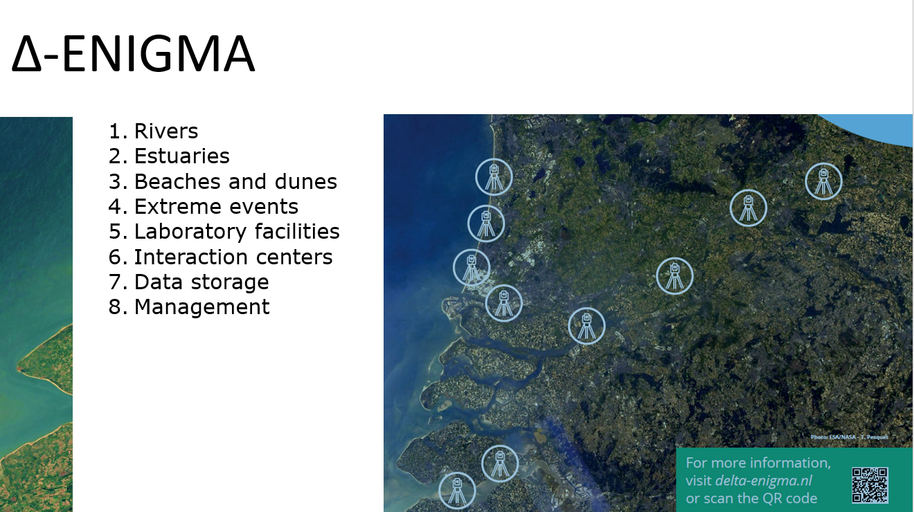

Slide 13
LandSeaLot Land-Sea interface: Let’s observe together!
Version May 2024

Slide 14
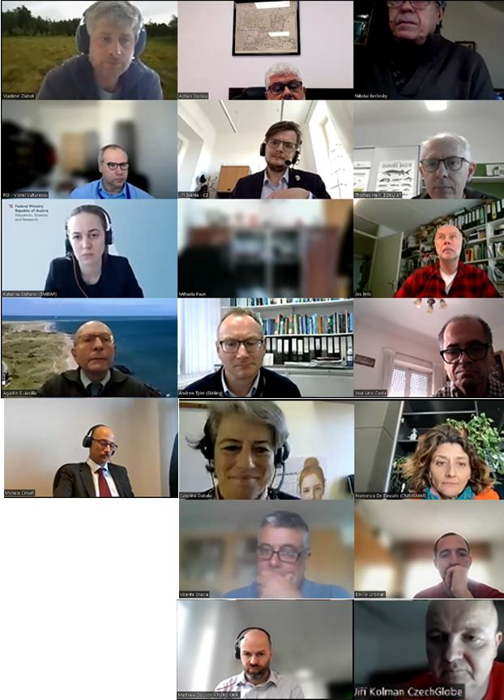
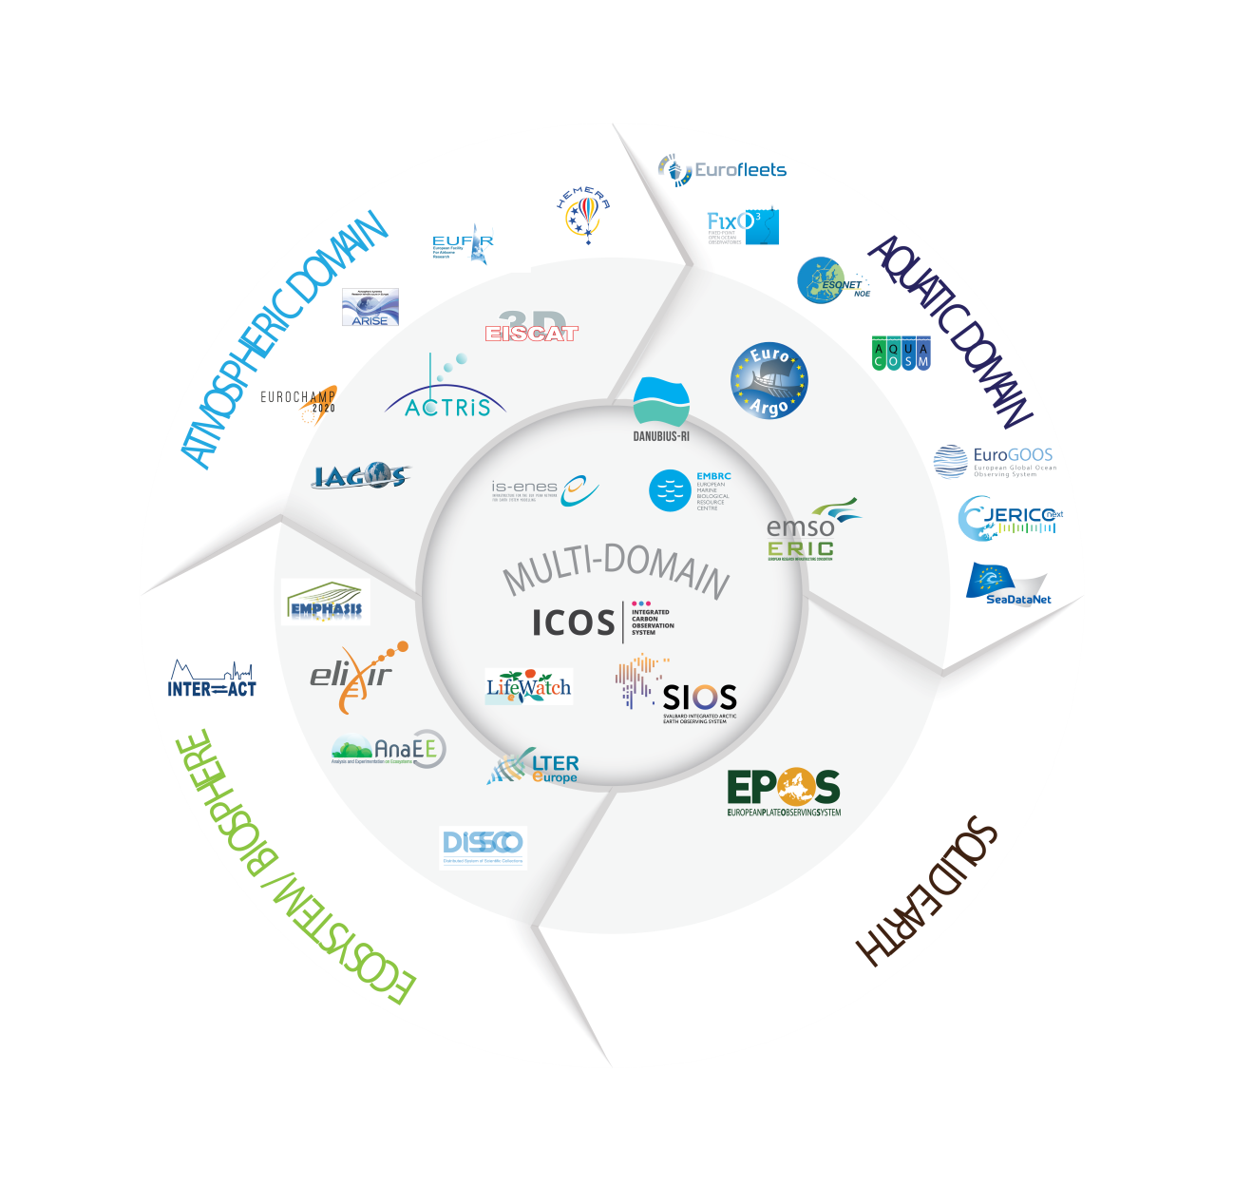


LandSeaLot:
powered by 3 RIs!
co-creation with another 4 RIs!

Slide 15
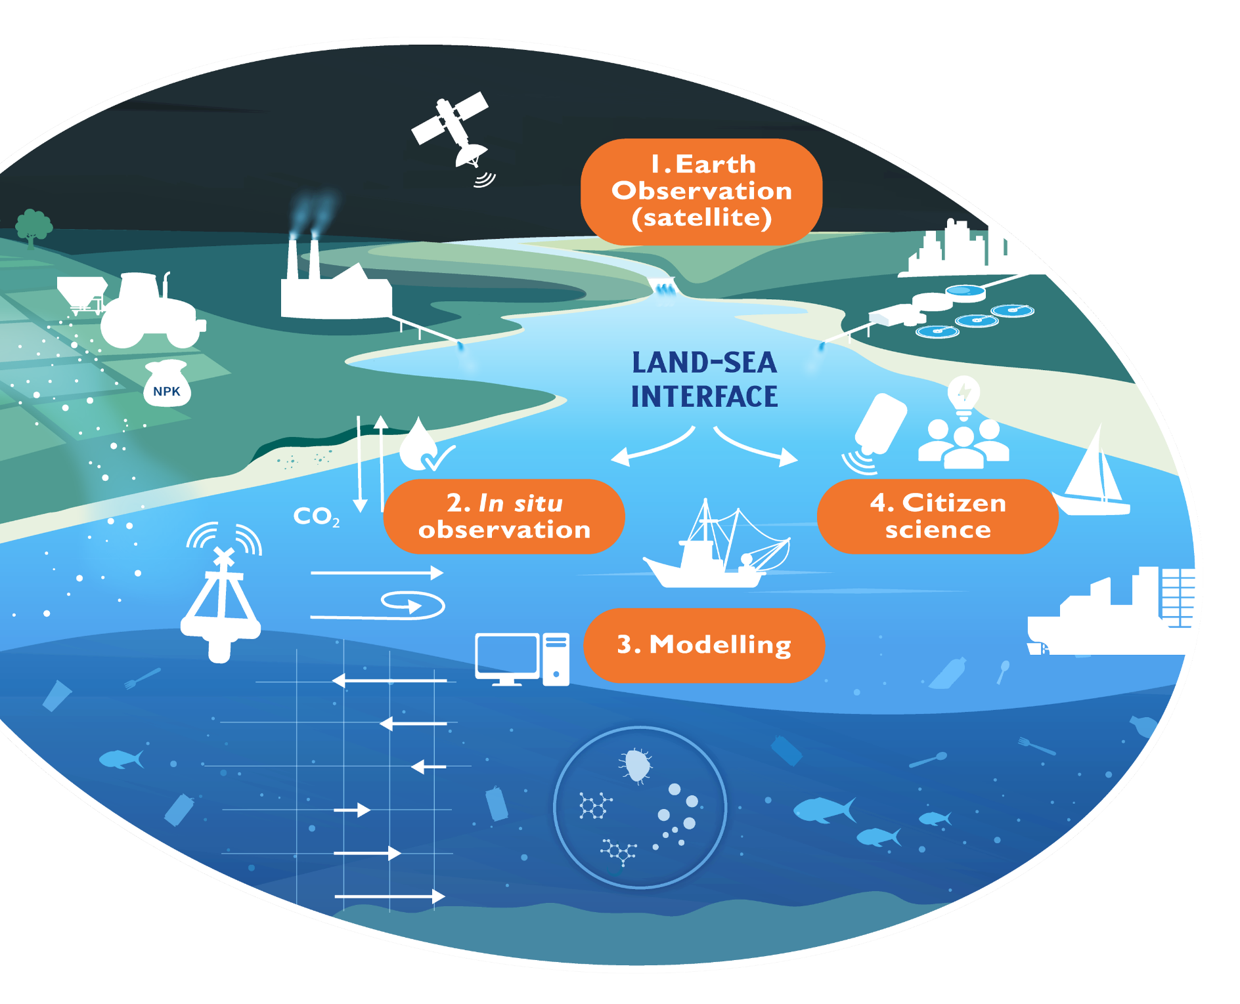
Project objective
LandSeaLot seeks to:
integrate, scale-up and enhance existing observation efforts
including in-situ, satellite, modelling and citizen science
to better study the land-sea interface
where terrestrial and marine habitats meet.

Slide 16
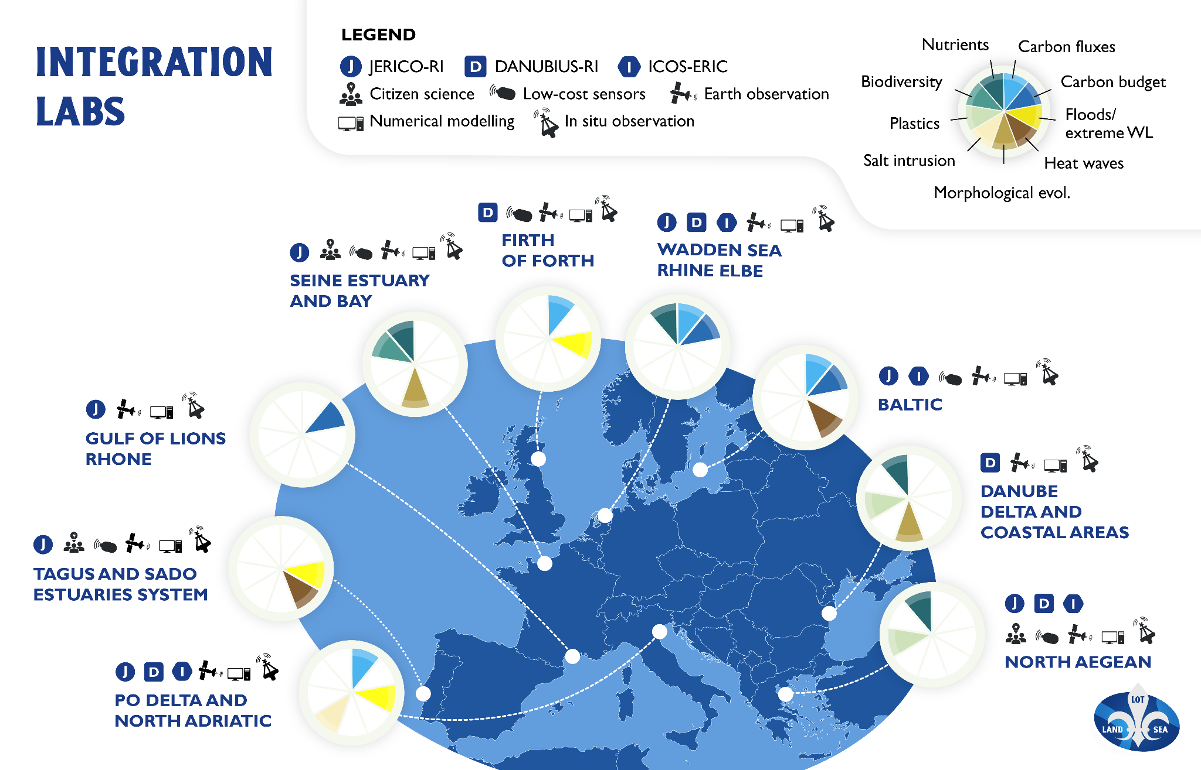
LandSeaLot Integration Labs (LILs)
Key societal challenges

Slide 18

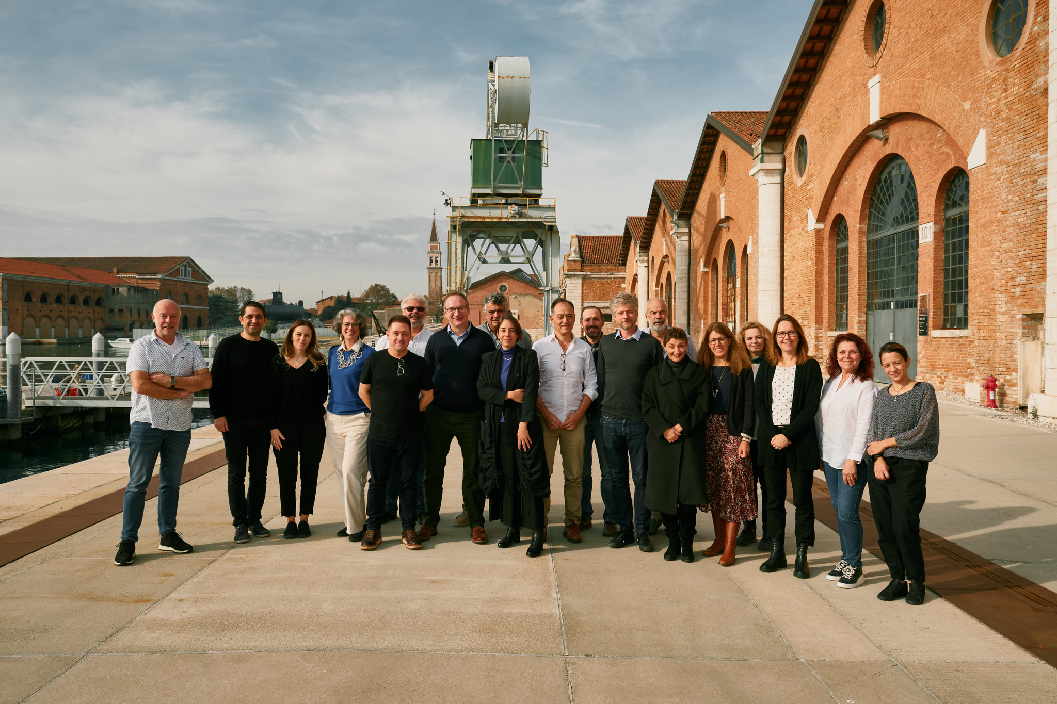
Thank you!
www.danubius-ri.eu
www.danubius-ip.tumblr.com
Delta ENIGMA | Home
Land-Sea Interface: Let’s Observe Together! - LandSeaLot
Image: Venice Sunset
Office Address
173 Narrow Lane, Falling Waters, WV 25419, America
DANUBIUS–RI “The International Centre For Advanced Studies On River-Sea Systems”

