Slide 1


CRIS Systems and Research Information Infrastructure
The initiative „Strengthening CRIS in the Institutes of the Leibniz Association “
IV International Conference „Open Science and Innovation in Ukraine 2025“
Kyiv, Ukraine - Hannover, Germany (online)
22 and 23 October 2025
Matthias Goeritz | Gregor Prinzensing | Philipp Steglich
Leibniz Association Headquarters

Slide 2


Agenda
Research Information and Current Research Information Systems (CRIS)
The Leibniz Association and the initiative „Strengthening CRIS“
APIs and data sources
Implementing and using CRIS

Slide 3


1
Research Information and Current Research Information Systems (CRIS)

Slide 4



Research data vs. Research information
Research data is not to be confused with research information.
Sometimes there is resistance to the open dissemination of research information because it is mistakenly considered to be research data.
Current Research Information Systems (CRIS) support work with research information. ‘CRIS’ is a generic term; there are many different systems from various manufacturers, some of which are open source,
e.g.: VIVO, OSIRIS, DSpace-CRIS and many more.
Research Data
Data generated by research
Data used for research
Research Information
Information about research
Metadata about publications, researchers, institutions etc.

Slide 5



What purposes can CRIS serve?
Ebert, B., Tobias, R., Beucke, D., Bliemeister, A., Friedrichsen, E., Heller, L., Herwig, S., Jahn, N., Kreysing, M., Müller, D., & Riechert, M. (2016). Forschungsinformationssysteme in Hochschulen und Forschungseinrichtungen. Positionspapier. Version 1.1. Zenodo. https://doi.org/10.5281/zenodo.45564
Focus areas of CRIS
External requirements
Internal requirements
  Monitoring of OA publications
  National and international standardisation of research information
  Communication and public relations
  Monitoring of OA publications
  Performance-based funding
  Monitoring and analyses
  Data basis for strategic decision making
  Reports
  Research portals, websites, profiles
  There are a wide variety of focus areas:
  Simple evidence systems (such as university bibliographies or research portals)
  Research profile services
  Integrated CRIS with multiple output and analysis functionalities

Slide 6










Current research information systems (CRIS) in Leibniz institutes
CRIS (Current Research Information System) is a generic term used to describe research information systems in general. The specific CRIS systems used in the Leibniz Association are shown here.
Proprietary CRIS
At least 40 Leibniz institutes are currently using one of these systems productively or are in the process of introducing one of these systems. The other institutions generally manage their research information using databases they have developed themselves or Excel.
Open Source CRIS

Slide 7
2
The Leibniz Association
and the initiative „Strengthening CRIS“

Slide 8


The Leibniz Association – an overview
The Leibniz Association connects 96 independent research institutions in Germany that range in focus from natural, engineering and environmental sciences to economics, spatial and social sciences and the humanities.
  Founded 1995
  An association of 96 independent institutes, including 17 infrastructure facilities and 8 research museums
  Financial volume € 2,2 billion (2023)
  Around 21,000 employees, including 12,000 scientists
  Evaluation every 7 years
  Strong regional roots in every German federal state
96 institutes
17 infrastructure
facilities
8 research museums
8
22 and 23 October 2025
IV International Conference „Open Science and Innovation in Ukraine 2025“

Slide 9
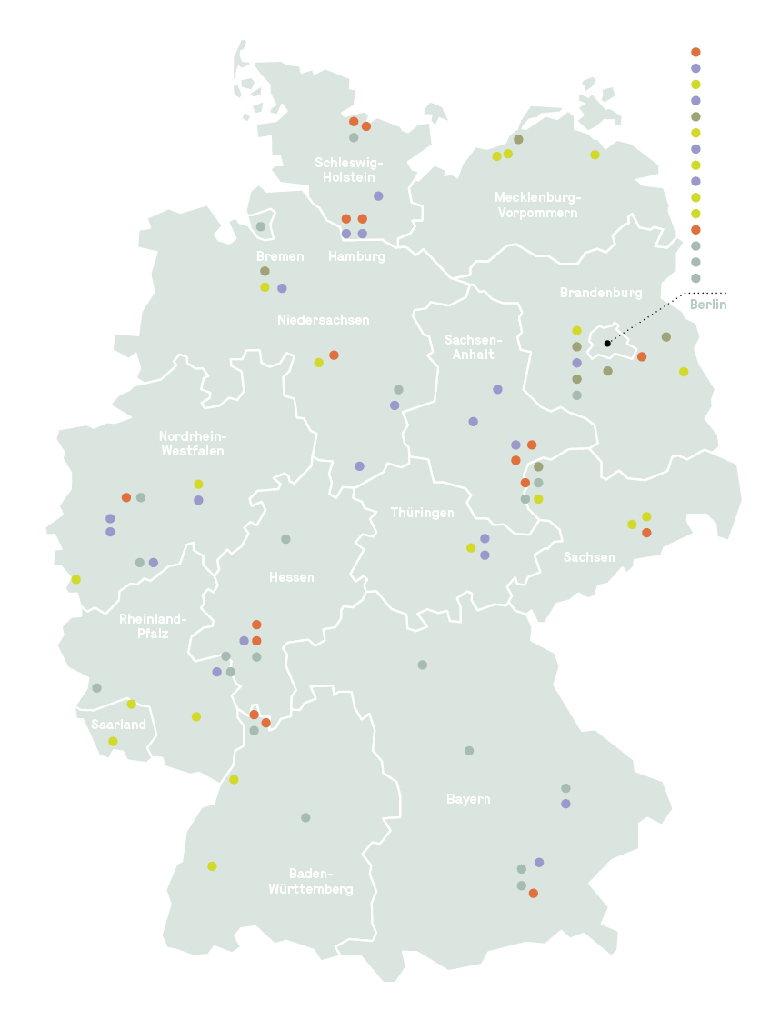
The sections of the Leibniz Association
Section A — Humanities and Educational Research
(23 institutes)
Section B — Economics, Social Sciences,
Spatial Research
(18 institutes)
Section C — Life Sciences
(24 institutes)
Section D — Mathematics, Natural Sciences
and Engineering
(23 institutes)
Section E — Environmental Research
(8 institutes)
9
22 and 23 October 2025
IV International Conference „Open Science and Innovation in Ukraine 2025“

Slide 10

The Leibniz initiative „Strengthening CRIS“
The Leibniz Association supports its institutes in introducing and further developing CRIS and in establishing and expanding the relevant skills.
Project duration: 3 years (November 2022 until Oktober 2025 – extended until Dezember 2025)
Leibniz institutes that do not currently use an integrated CRIS receive comprehensive support
    in the selection process,
    in the process of introducing a CRIS,
    and in further competence building.
Support is also provided to Leibniz institutions that already use CRIS – in the areas of competence building and further development.
The initiative focuses in particular on strengthening and supporting the Leibniz CRIS community, as well as open research information and open source CRIS.
Strengthening CRIS
10
22 and 23 October 2025
IV International Conference „Open Science and Innovation in Ukraine 2025“

Slide 11

Main goals of the Leibniz initiative „Strengthening CRIS“
To generally improve the quality, visibility and interoperability of research information.
Create easy access to up-to-date information (metadata) that offers added value for research policy, management and the public.
Establish flexible technical platforms in an open community process that support important standards (e.g. KDSF) and help to further develop them according to their practical benefits.
Support the Leibniz Association’s efforts to achieve the goals specified in the Barcelona Declaration on Open Research Information
The initiative thus stands for the strategic and technical further development of CRIS as a joint task:
    practice-oriented,
    oriented towards standards,
    open to dialogue.
Strengthening CRIS
11
22 and 23 October 2025
IV International Conference „Open Science and Innovation in Ukraine 2025“

Slide 12





Activities of the Leibniz initiative „Strengthening CRIS“
All activities are centered around the Leibniz CRIS Community.
More than 20 online workshops and annual in-person „CRIS Days“
Financial incentives for external CRIS consultancy services and implementations of Open Source CRIS
Provision of information and CRIS profiles via a wiki
Signing of the Barcelona Declaration on Open Research Information – commitment to openness as the default for research information
National and international networking (KFiD, euroCRIS, Barcelona working groups…)
Based on feedback from the Leibniz CRIS community and surveys, the ‘Strengthening CRIS’ initiative has led to significant progress in the introduction and further development of CRIS and in working with research information at many Leibniz institutes
12
22 and 23 October 2025
IV International Conference „Open Science and Innovation in Ukraine 2025“

Slide 13
Challenges in implementing CRIS
Data basis:
Survey of all 96 institutes in the Leibniz Association
Survey period: January 2023
68 responses were received from 65 Leibniz institutes
Main challenges:
Lack of resources and major organisational changes
13
22 and 23 October 2025
IV International Conference „Open Science and Innovation in Ukraine 2025“

Slide 14
Satisfaction with CRIS situation
Data basis:
Survey of all 96 institutes in the Leibniz Association
Survey period: April 2024
71 responses were received from 61 Leibniz institutes
CRIS use greatly increases satisfaction, especially use of Open Source CRIS.

Slide 15
3
APIs and data sources

Slide 16



Connecting different research information sources
In addition to self-reporting or (semi-)centralised recording:
Data from own systems
Licensing proprietary databases
Using open databases
  In the leading system: data maintenance, quality assurance
  Is the process established? Is it running smoothly?
  Is the data quality acceptable?
  e. g. Web of Science, Dimensions, Scopus
  additional costs
  uneven standardization
  deduplication necessary
  e. g. OpenAlex
  no licensing costs
  data quality must be checked

Slide 17

Use of APIs and Standards
  APIs (application programming interfaces) are often used for:
                Displaying CRIS-information on websites (CMS)
                Importing data from HR software
                Creating and maintaining user accounts (often using ActiveDirectory)
                Importing data from financial or project management software
  Persistent Identifiers (PIDs): There are many PIDs, some that are commonly used are DOI, GND, Handle, ISBN, ORCID, PubMed-Identifier, ROR, Scopus-Identifier…
  Research information management standards are often based on reporting requirements
17
22 and 23 October 2025
IV International Conference „Open Science and Innovation in Ukraine 2025“

Slide 18







APIs – possible external data sources
  These are some examples of online databases (open and proprietary) that can serve as data sources for CRIS via an API.
18
22 and 23 October 2025
IV International Conference „Open Science and Innovation in Ukraine 2025“

Slide 19
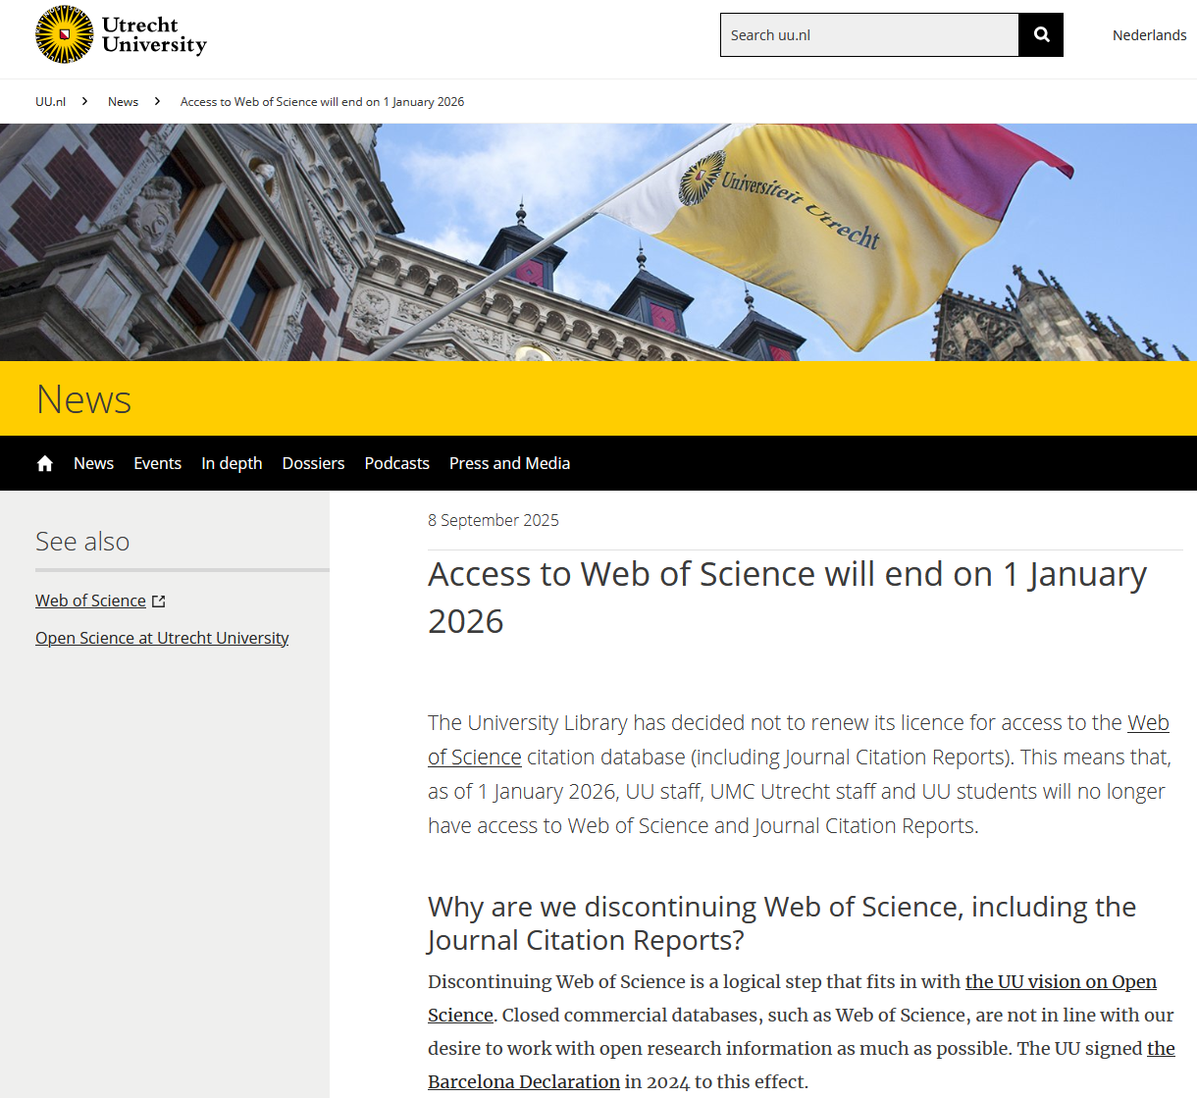
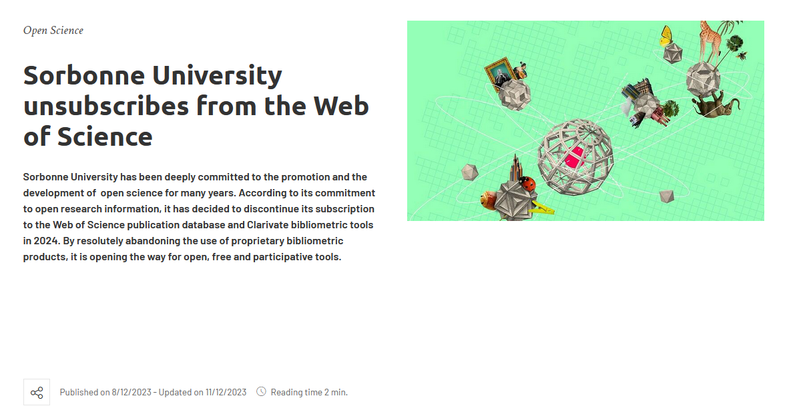
International developments
    More than 100 organisations worldwide have signed the Barcelona Declaration.
    Some universities are currently terminating their access to fee-based, proprietary bibliometric databases in favor of open alternatives.
    https://www.uu.nl/en/news/access-to-web-of-science-will-end-on-1-january-2026
    https://www.sorbonne-universite.fr/en/news/sorbonne-university-unsubscribes-web-science
19
22 and 23 October 2025
IV International Conference „Open Science and Innovation in Ukraine 2025“

Slide 20
4
Implementing and using CRIS

Slide 21
Types of research information – types of metadata
Master data
(people, Organisations
- internal as well as external)
Projects
(applications, approvals)
Activities
(Lectures, events, reviews, consultations, press/media, etc.)
Financial data
  What research information should be recorded in CRIS?
  What is absolutely necessary?
  What is desirable?
  What is possible?
  What are the ‘low hanging fruits’?
  How detailed should the records be?
  What standards should be used?
Promotion of young researchers
(master's theses, doctoral theses, postdoctoral qualifications, examinations, expert opinions)
Teaching
Awards
(honours etc.)
Publications
(articles, journals, publishers, posters, etc.)
Patents
(spin-offs)
Fellowships
(incoming / outgoing)
…

Slide 22
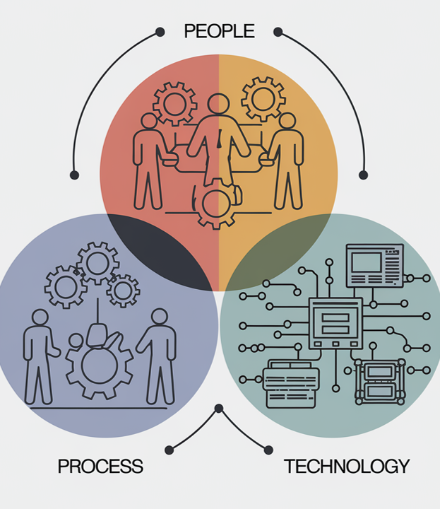
CRIS: a digitalisation and organisational development project
The People Process Technology Framework was (further) developed by Harold Leavitt (1960ff) & Bruce Schneider (1990ff).
The introduction of CRIS is not purely an IT project, but rather a long-term digitalisation and organisational development project. This requires resources (in terms of personnel, time and money), but also offers great opportunities.
Focus on internal processes, responsibilities, internal cooperation and the way things are ‘done’ at the institute.
Important factors include: structural and procedural organisation, change management, the institute's own understanding of quality, the organisational culture and the upskilling of its own staff and the community.
Entire processes can be implemented or improved via CRIS (in some cases with the involvement of other systems via interfaces), e.g.:
    Onboarding and offboarding processes
    Status transitions in employment relationships
    Aspects of project management
    Updating websites, CVs and reports
    …

Slide 23

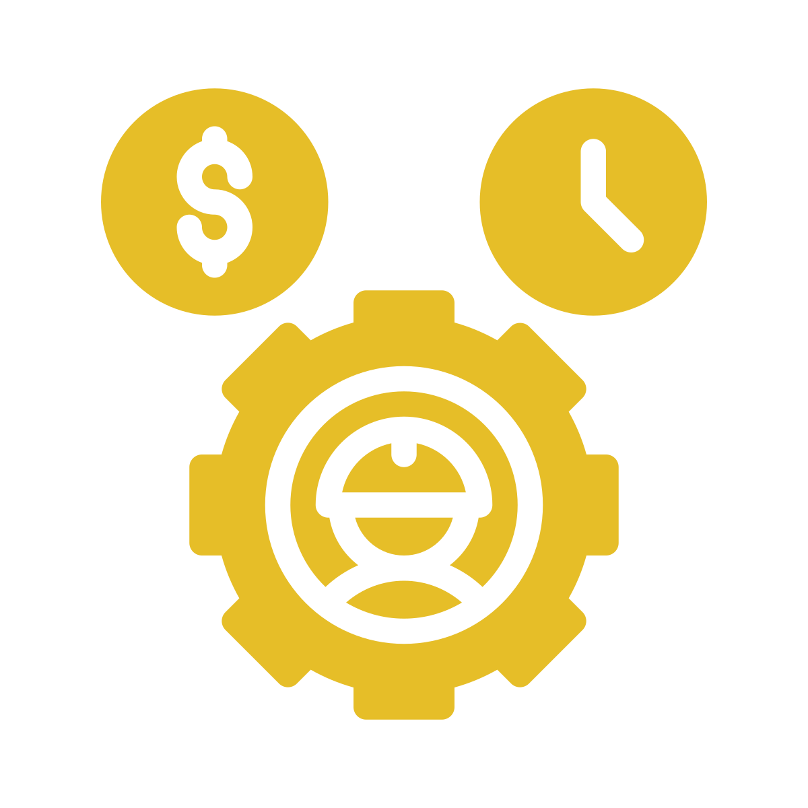

Resources – what to consider (material resources, personnel)
One-time costs for software and hardware
Project costs = implementation costs
Operating costs
  One-off acquisition/procurement costs, including licence fees (can be avoided by using open source software) or costs for new hardware
  One-off costs, including temporary personnel expenses for project management and internal CRIS readiness
  Annual material and personnel costs for data entry and maintenance, system maintenance, user training, etc.

Slide 24






Resources – what to consider (conditions)
Entire organisation
Open Source Software
Cloud (SaaS)
or
or
or
Institutes
Proprietary software
On premise installation
  Differences in the magnitude of costs depending on scope, but with consequences for project management and operations when creating APIs
  Personnel and material costs are incurred on an ongoing basis, with costs arising in different areas.
  Purchasing services or providing IT yourself, questions of backups and cyber security, control over and responsibility for your own data

Slide 25

Definition of objectives for the acquisition
Before implementing a CRIS (open source or proprietary), care must be taken to ensure that the software meets all requirements. Such requirements could include, for example:
The CRIS sought should be adaptable in terms of its data model and standardised data storage.
It should have connections to other (open) systems via APIs and also be able to connect bidirectionally to (open) research information infrastructures, e.g. OpenAlex
It should be able to incorporate all applicable PIDs (identifiers) as far as possible and must be capable of further development towards new identifiers.
It should be possible to analyse and visualise already available data (reporting).
It all depends on the purposes your individual CRIS is meant to serve.
25
22 and 23 October 2025
IV International Conference „Open Science and Innovation in Ukraine 2025“

Slide 26



Recommendations – Motivation and acceptance
CRIS – Proof of concept
External consulting
A small group of motivated people could take the lead and loudly proclaim what they are going to do, inviting others to join them. This can also be done in several stages. Set the right goals (‘low hanging fruits’) where you can show yourself and others after a short time that ‘we have achieved a lot with few resources’.
Seek professional advice. There are product-neutral consulting companies that are experts in their field. Such consulting services are useful during any stage of the CRIS implementation process and can help identifiy and solve problems before they arise.

Slide 27


Recommendations – CRIS readiness
Integration into the system landscape
Collect requirements
Check existing central systems in the administrations for their suitability as data sources. Find out where processes are already well established and already generate an acceptable level of quality. What role does person-specific knowledge play in this?
Prepare mappings by precisely recording which data you can obtain from which systems and in what format and quality. At the same time, collect the requirements and questions from the departments that will be decisive for the future system and systematise them in writing.

Slide 28





Overcoming obstacles to cooperation
Between:
Entire organisation/Community
Management level
Scientific staff
Institutes
Working level
Administrative staff

Slide 29

Initiative “Strengthening CRIS”: Lessons Learned
  Community work has a stronger impact on CRIS competence development and willingness to implement CRIS than financial incentives
  Support initiatives are met with great approval and gratitude
  It is worthwhile to think beyond classic reporting tasks, as CRIS can be used as strategic tools
  The great potential of CRIS can only be exploited if the appropriate resources are made available
  Especially cross-institutional collaboration and the use of external data sources/databases require standards
  PIDs are relatively easy-to-implement aspects of standards
  Costs: Highly dependent on the specific solution; personnel costs (including long-term!) must always be taken into account (not only for open source, but also for proprietary CRIS)
29
22 and 23 October 2025
IV International Conference „Open Science and Innovation in Ukraine 2025“

Slide 30
Thank you for your time
Some illustrations in this presentation were generated using artificial intelligence (AI) in October 2025.
The illustrations on pages 22 and 29 were created using Ideogram, the illustrations on pages 25 and 26 were created using GPT Image Editor; they are all free from copyright.
The ‘Guideline on the Use of Generative Artificial Intelligence (AI) in the Leibniz Association’s Headquarters’, https://doi.org/10.5281/zenodo.15162387, was followed.
Leibniz Association
Chausseestrasse 111
10115 Berlin, Deutschland
cris@leibniz-association.eu
www.leibniz-association.eu

