Slide 1
Research Infrastructures in European policy context
Jan Hrušák

Slide 2
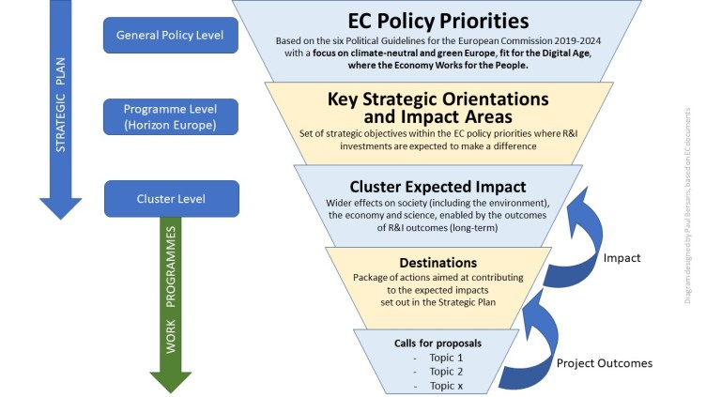
MS&EC&EP
MS&EC ERA Policy
ERAC, ESFRI, ERA Forum
MS&EC – HEU PC
Annual WP
The Union and the Member States shall coordinate their research and technological development activities so as to ensure that national policies and Union policy are mutually consistent.
ERA Actions
Policy Implementation
interface
A multiannual FP, setting out all the activities of the Union, shall be adopted by the EP and the Council,
Stakeholder contributions
Prioretization of R&I activities top/down
EU funded Research -> support EU policies
(Articles 179-189 of the Lisbon Treaty that regulates the EU since December 1, 2009 provide is the legal basis for EU`s Framework programmes and other R&I activities)

Slide 3
Global perspective of RIs: ESFRI objectives
01
The European Strategy Forum on Research Infrastructures (ESFRI) plays a crucial role as a policy advisory body within the European Union. ESFRI was established in 2002 to develop a coherent and strategy-driven approach to research infrastructures in Europe.
02
ESFRI acts as a central platform for strategic thinking and collaboration, guiding the development of research infrastructures in Europe and contributing to the region's competitiveness in the global scientific landscape.
Interconnected RI ecosystem - globally interconnected and operating in open access mode (TNA)

Slide 4
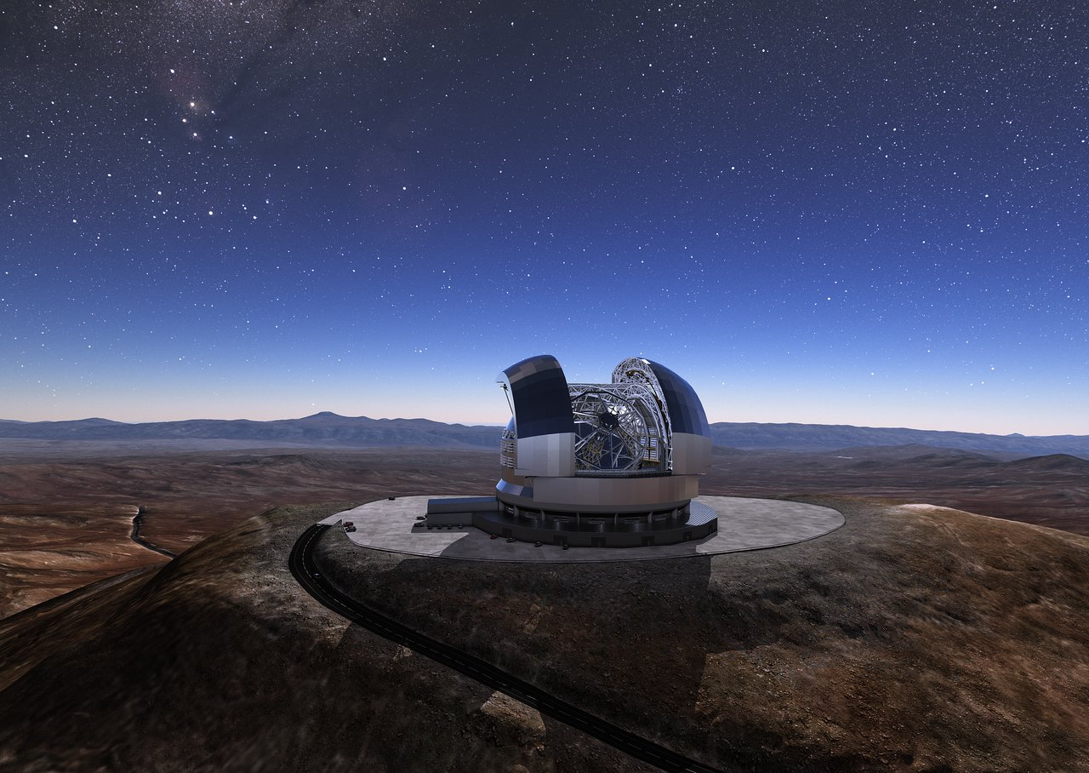
ESFRI Vision:
Equipping Europe with infrastructures for ground-breaking research
Efficient RIs enable greatest discoveries
in science and technology
Allow the training of researchers
Build bridges between research communities
Attract researchers from around the world
Facilitate innovation and knowledge-sharing

Slide 5
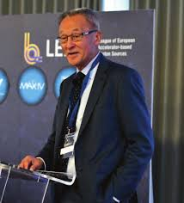

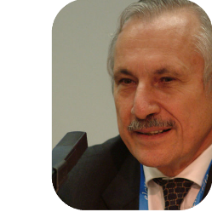





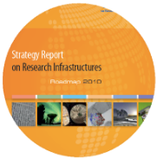
ESFRI (Roadmapping) concept evolution
2002
2006
2008
2010
2016
ESFRI Concept ESFRI established with a mandate from the Council of the EU | 1st ROADMAP for the construction and development of the next generation of pan-European RIs | 1st UPDATE Increasing the number of RIs of pan-European relevance | 2nd UPDATE focusing on Energy, Food and Biology | Update process identified projects expected to move to implementation (LM) in <10 years from their first inclusion on the Roadmap.
Hans Chang
John Wood
Carlo Rizzuto
Beatrix
Vierkorn-Rudolph
John Womersley
Startegic policy advice to Council of ministers, RIs Roadmaps, RI Landscapes, ESFRI scripta and reports

Slide 6

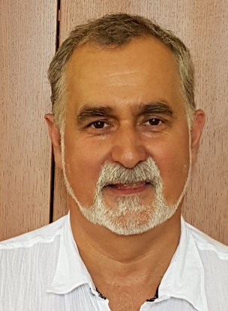
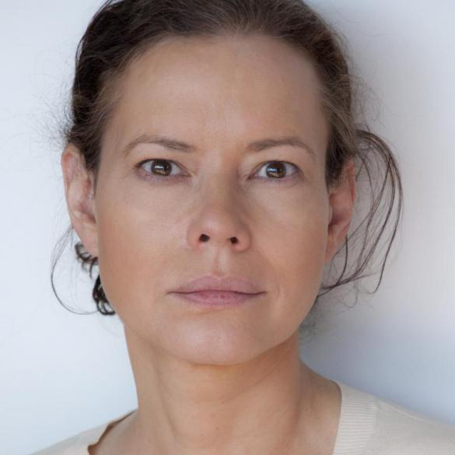
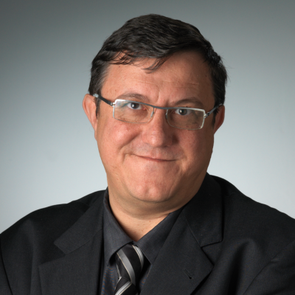
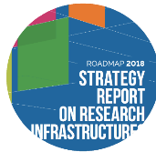
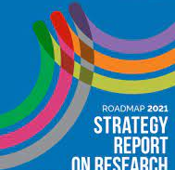
ESFRI (Roadmapping) concept evolution
2016 - 2018
2018 - 2021
2022 - 2023
2024
2002
Consolidation & incorporation of the mandates of Council: sustainability, innovation, and hub of funders of e-infra | Integration &relevance strategic positioning in ERA; paradigm shift from planning to operation, joint ESFRI vision - the ESFRI White Paper | Integration of RIs in the renewed ERA, Landscape Analysis in 2023, increasing cooperation with industry and technological infrastructures
Global perspective integration &implementation of strategic positioning in ERA; new ESFRI Roadmap to be presented in 2025/2026
Giorgio Rossi
Jan Hrušák
Jana Kolar
José Luis Martínez Peña
RM 2021: RIs (22 projects and 41 landmarks) next RM 2025 / 26

Slide 7
ESFRI organization
Chair & Executive Board
(≈ 6-8 members)
General Forum
Max. 2 members + max. 2 advisors per MS/AC + EC as secretariat (≈ 40-50 people)
Strategic Working Groups (SWG)
≈ 8-16 experts nominated by the MS/AC, max. 1 expert per MS/AC per SWG
Digital (DIGIT)
Health & Food (H&F)
Environment (ENV)
Energy (ENE)
Physical Sciences and Engineering (PSE) Social Sciences and Humanities (SSH)
Monitoring Committee
Responsible for overseeing the monitoring process on behalf of ESFRI
Implementation Group
(≈ 6-10 members) for the transverse aspects in new projects in the RoadMap
Ad-hoc Expert WGs

Slide 8
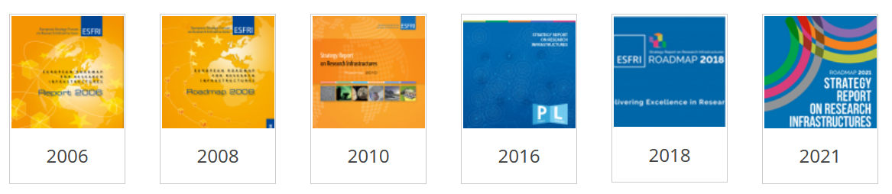
ESFRI Roadmaps
The latest update of the ESFRI Roadmap 2021 presents a total of 63 European research infrastructures, of which 41 are in the "ESFRI Landmark" category and 22 in the "ESFRI Project" category. (https://www.esfri.eu/ )
RI-ecosystem contains e-Infras&EOSC (data management) =>
Dedicated calls
ESFRI RM mobilized ~20 b€ of joint MS investment into RIs and over 2 b€/year operational costs

Slide 9
Thank you!
hrusak@jh-inst.cas.cz
Jan Hrušák

