Slide 1
Indexation basics
IV International Conference "Open Science and Innovation in Ukraine 2025
Geraldine Lovell, Senior Indexation Manager, Elsevier
Oct 2025

Slide 2
Topics we are covering:
Main indexation services vs ‘the others’
DOAJ
Web of Science (Clarivate)
How the Impact Factor is calculated
Tips
Scopus
How Citescore is calculated
Tips
PubMed
PubMed Central
Medline
Questions?

Slide 3
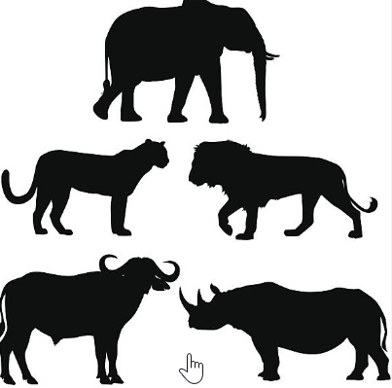
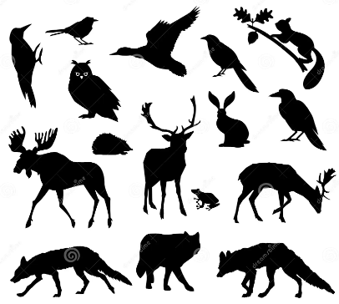
Indexation services
The ‘Big 5’
Web of Science
ESCI, SCIE, SSCI
Scopus
PubMed Central (PMC)
Medline
Directory of Open Access Journals (DOAJ)
The ‘Others’
GeoRef (AGI)
CABI / Cab abstracts
MathSciNet
INSPEC
CAS GO-OA
PsycINFO (APA).........

Slide 4

DOAJ (Directory of Open Access Journals)
Free, community-curated online directory of high-quality, open-access journals.
Covers all disciplines and languages.
Journals must adhere to strict quality and transparency standards.
Promotes open access to scholarly research. Aims to increase the visibility, accessibility, and usage of open-access journals.
Can apply after 10 articles published
Strict endogeny rules can influence acceptance
Usually the first indexation service to accept a journal. Other indexation services will note this on their site
Early visibility of articles on first indexation platform
What this means for Publishers and Researchers:

Slide 5

Web of Science – WoS (Clarivate) – Impact Factor
A multidisciplinary research database managed by Clarivate Analytics.
Includes high-impact journals, conference proceedings, and books.
Provides citation analysis and metrics (e.g., Impact Factor).
Focuses on quality and peer-reviewed content.
Frequently used for bibliometric and academic performance analysis.
Long application/acceptance process
Many researchers prefer to publish in SCIE/SSCI journals that are high-impact
Categories/rankings are now merged to combine SCIE/SSCI/ESCI content
Some ESCI journals ranking higher than SCIE/SSCI.
Can take up to 8 weeks for new content to appear on WoS
What this means for Publishers and Researchers:

Slide 6
How is Impact Factor (IF) calculated?
The IF measures a journal's influence based on citations
Impact Factor = Citations in Year X to articles from (X-1) and (X-2)
-----------------------------------------------
Total citable articles in (X-1) and (X-2)
Example Calculation (2023 JIF)
500 citations (in 2023) to 2021-2022 articles
100 citable articles (published in 2021-2022)
Impact Factor = 500 / 100 = **5.0**
✅ Only **research articles & reviews** count (not editorials, letters, etc.)
✅ Impact Factor is updated **annually**
✅ A 5-year Impact Factor gives a broader citation window

Slide 7

Web of Science - tips
For researchers/authors:
Editors included as authors – needs COI
No irrelevant references, also to retracted articles
Conflicting or missing ethical statements should be avoided, ie
‘Patient Consent was waived’ then later, ‘Patient Consent was obtained’
Submit your article as the correct article type: paper submitted as Letter to the Editor, but is really a Case Report will cause problems
Authorship contribution statement preferred
All papers should have an English title and abstract for indexation
Most important: make sure all ethical statements are included and correct!

Slide 8
Web of Science – tips continued
For Publishers or Societies that are self-publishing:
Accept the best scientific quality articles that you can (key to indexation)
Regular discussions with board on ethical standards. How can these be checked at the point of submission?
Stick to publication schedule and aims/scope
Ensure your journal home page is up-to-date with full editorial board info, plus their affiliations. Add URLs to societies or working groups such https://www.icmje.org/about-icmje/
Special issues should be relevant to the journal. Guest Editors also need full affiliation details
Stick to what you state in your Information for Authors. Indexation services consult these closely.

Slide 9

Scopus (CiteScore)
A multidisciplinary database managed by Elsevier.
Covers peer-reviewed journals, books, and conference papers.
Focuses on international scholarly output across all disciplines.
Offers author profiles and tools for citation tracking and analytics.
Used widely for academic impact evaluation (e.g., h-index).
High acceptance rate for well-known publishers – application results known within a year
CiteScore tracker available once journal page is live on Scopus
Release of yearly CiteScore in April
What this means for Publishers and Researchers:

Slide 10
How is CiteScore calculated?
Measures a journal’s impact over a **4-year citation window
CiteScore = Total citations in Year X to articles from (X-1) to (X-4)
------------------------------------------------------
Total citable documents from (X-1) to (X-4)
Example Calculation (2023 CiteScore)**
800 citations** (in 2023) to articles published in 2019-2022
200 documents published in 2019-2022
CiteScore = 800 / 200 = **4.0**
✅ Key Differences Between CiteScore & Impact Factor
✅ CiteScore: 4-year window, includes all document types, from Scopus
✅ Impact Factor: 2-year window, only research articles & reviews, from WoS

Slide 11

Scopus - tips
For researchers/authors:
Article should contribute to academic field with high-quality research
Scopus focus strongly on citations – share your work as broadly as possible to help generate these
Follow journal guidelines closely; Scopus editors will look for compliance
If required, consider professional editing services to refine grammar and clarity
List all contributing authors and avoid ghost or honorary authorship
Write a strong cover letter: briefly explain your paper’s importance, how it fits the journal, and why it should be published.

Slide 12
Scopus tips - continued
For Publishers/Societies:
Ensure journal meets Scopus requirements (peer reviewed, ISSN, regular publication, diverse authorship and board
Clear processes described on your journal home page
Ensure a clear peer-review process (double-blind or single-blind).
Follow COPE guidelines (https://publicationethics.org/)
Focus on obtaining original, high-impact research with global relevance.
Maintain high citation rates by encouraging authors to promote their work.

Slide 13

PubMed
A free search engine from the U.S. National Library of Medicine (NLM).
Focuses on biomedical and life sciences literature.
Includes citations and abstracts from MEDLINE and other sources.
Often used by researchers, healthcare professionals, and students.
Does not include full-text articles (links to publishers instead).
No application process for PubMed. If accepted for PubMed Central or Medline then citations/abstracts will automatically flow through to PubMed Search Engine (typically 3 days later)
Funded papers (ie, Wellcome Trust, NIH-funded, other European funders) will also have citations on PubMed
Automatic process, no input required from publishers, researchers
What this means for Publishers and Researchers:

Slide 14

PubMed Central (PMC)
A free full-text archive of biomedical and life sciences articles.
Managed by the U.S. National Institutes of Health (NIH).
Complements PubMed by providing open-access content.
Ensures long-term preservation of scholarly literature.
Articles must meet specific technical and content standards to be included.
Publishers must apply for inclusion; review process is around 5 months
Once accepted, PMC usually accept 2 years of back-data
All new articles from researchers to an accepted journal will flow automatically through to PMC
Citations will flow through to PubMed (search engine) also
What this means for Publishers and Researchers:

Slide 15

Medline
The main component of PubMed, curated by the National Library of Medicine.
Covers over 5,200 journals in medicine, nursing, dentistry, and healthcare.
Indexed using Medical Subject Headings (MeSH) for standardized search terms.
Includes citations, abstracts, and sometimes links to full-text articles.
Focuses on rigorously selected biomedical literature.
Only 12% of titles reviewed by Medline committee are accepted
One of the last indexation services that major publishers apply for, due to very low acceptance rate.
What this means for Publishers and Researchers:

Slide 16
Any questions?

