Slide 1
Submitting to a Gold Open Access Journal at Elsevier: A Workshop for Early-Career Researchers
ІV International Conference
Open Science and Innovation in Ukraine 2025
https://conference2025.dntb.gov.ua/en/
Kyiv, Ukraine – Hanover, Germany (online)
Thursday 23rd October 2025
Dr. Lucy Bennison-Chapman
PhD Archaeology
Scientific Editor, Social Sciences and Humanities Open journal, Elsevier
Notes:
thank you so much for joining us today for this workshop on how to get published with Elsevier
By the end of the session, attendees will have a clearer understanding of the publication process and be better equipped to successfully publish their research with Elsevier Open Access as well as knowing where to find useful resources .

Slide 2


Presenter
Dr. Lucy Bennison-Chapman, PhD archaeology
Scientific Editor
Social Sciences & Humanities Open, Elsevier
Amsterdam, the Netherlands
Lucy Bennison-Chapman studied in the UK, specializing in history and the archaeology of Ancient Egypt and West Asia. She obtained her PhD in the Archaeology of the Neolithic in West Asia, from the University of Liverpool, July 2015. She held PhD fellowships in Ankara (Türkiye) and Amman (Jordan) and was the Doctoral Teaching Fellow at the University of Liverpool (UK). Lucy has undertaken fieldwork at excavations in central Türkiye, Syria, Kuwait in addition to a number of university and museum-based research placements. After a two-year position as Assistant Professor of Prehistoric Archaeology at Zonguldak Bülent Ecevit University (Türkiye), Lucy became the inaugural Postdoctoral Research Fellow at the Netherlands Institute for the Near East (NINO), Leiden University (2019-2022) where she organised and hosted a multi-disciplinary conference investigating the origins and use of non-written recording systems. She has published extensively in international academic journals and peer reviewed monographs and edited a book on the origins of administration (Peeters 2023).
Social Sciences & Humanities Open
is multidisciplinary, Gold open access scientific journal covering all areas of the social sciences, economics, and arts humanities.
Notes:
A little bit about me
I am Lucy Bennison-Chapman, I have a PhD archaeology from the Uni of Liverpool, England, UK
Worked as a lecturer and researcher at excavations in UK, Middle East, Turkey and the Netherlands,
I have published a number of journal articles and book chapters and as a result of a post-doc in the Netherlands, a book also
[CLICK]
I have worked at Elsevier for just over 3 years and I am one of three scientific editors for the journal Social Sciences and Humanities Open, an open access, multi-disciplinary journal

Slide 3

Agenda
By the end of the session, attendees will have a clearer understanding of the publication process, know where to find useful resources and be better equipped to successfully publish their research with Elsevier Open Access.
1. Finding the right journal
2. Before writing up your research
3. Structuring the article
4. Submitting your article
5. Common pitfalls
6. Ethical issues
7. Submission Journey: The assessment and review process
8. Resources
Notes:
I will present on how to get published – walk you through the entire [process from finding a journal to the final decision and beyond
By the end of the session, attendees will have a clearer understanding of the publication process and be better equipped to successfully publish their research with Elsevier Open Access as well as knowing where to find useful resources .

Slide 4


1. How to find the correct journal for your research
Notes:
So, you are all here because you want to know how to successfully publish in an Elsevier journal
step one-
decide which of the many thousands of journals to submit your article to
Critically, this should be done BEFORE you finish the research and def. before you write up.

Slide 5
Journal types
Subscription – Open Access – Hybrid
Check the journal’s homepage under “Open Access Options”
Open Access –Author (or their funder/institution) pays the APC
Free for all to read, no log on or subscription needed
Subscription – Author pays nothing to publish
Academic libraries pay a subscription for their library members to read
Non-affiliated readers member of the public can purchase individual articles to read online
Hybrid journal – Allows the Author to chose
Only some of the journal’s articles are freely available to download and read
Know your funding status and any requirements of your project/funder/institution, and of any institutional library agreements BEFORE submitting
Notes:
First thing to consider it the Journal type- in terms of the financial model
Subscription versus Open Access or Hybrid
This will always be clear on any journals home page
Explain the three models BRIEFLY

Slide 6
Publishing in an Open Access journal
Gold Open Access Journals
What is a Gold Open Access journal?
Do I need to pay an Article Processing Charge (APC)?
Ukrainian Researcher support scheme
Institutional agreements
APC waivers/promotions – new launch titles
Geographical Pricing scheme (including countries affected by war and political upheavals)
Why publish in a Gold OA journal?
Funder mandates
Speed/scope
Wider reach
Personal preference
Open Science
Open science
Open access
Open data and transparent reporting
Open indicators
and research evaluation
Science and society
Open tools and software
Notes:
-Importantly for this audience, Elsevier is currently waive APCs for articles submitted to gold open access journals that have a corresponding author with a Ukrainian affiliation. The waiving is done automatically, and we will communicate that clearly to the author during the publication process.
Green open access
A version of a subscription article is made freely available
Relies on the subscription model to continue to operate
Usually after an embargo period
Normally a draft copy of the article

Slide 7
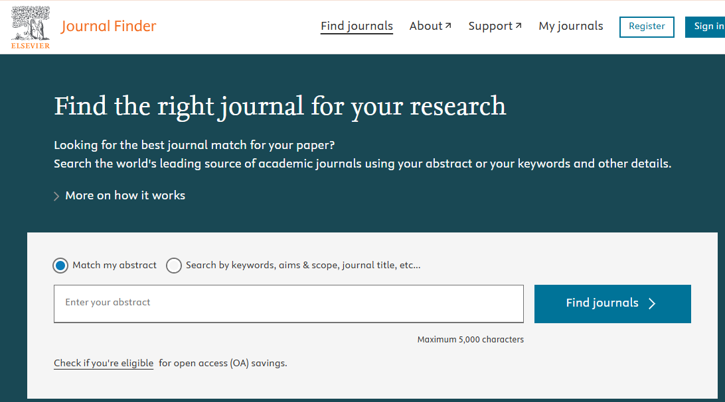
Which journal? Subject Focus and Study Type
Visit your library:
What journals are in the library section you usually visit?
What journal's do you usually read for your research?
Ask supervisor and colleagues for good suggestions for your output-can recommend the most prestigious in the field
Elsevier Journal Finder:
Search by keyword
Search by Journal title
Paste in your draft abstract/opening
paragraph
Notes:
First, define your
1. Broad subject/discipline
1.1 Sub-discipline
2. Article type (book review, review article, case-report, standard full length article short communication etc. etc.)
(1. Discipline)
Some journals will take all Literature ,others will focus on Modern Indian Literature in English, or Feminist Literature for example
Some journals want interdisciplinary studies, others have a very specific and narrow focus
(2. Study type)
Is your research a Review Article, is it quantitative or qualitative?
Again, different journals accept different study types only
Once you have this, narrow down the options
How to narrow down the options:
Look at the journals you usually use for your research, in your teaching, ask colleagues, peers, supervisors for their recommendations on where to publish your study
Considering the type and scope of your research
Use the Elsevier journal finder to filter for options also
Do need to scrutinise the results
Then…..

Slide 8
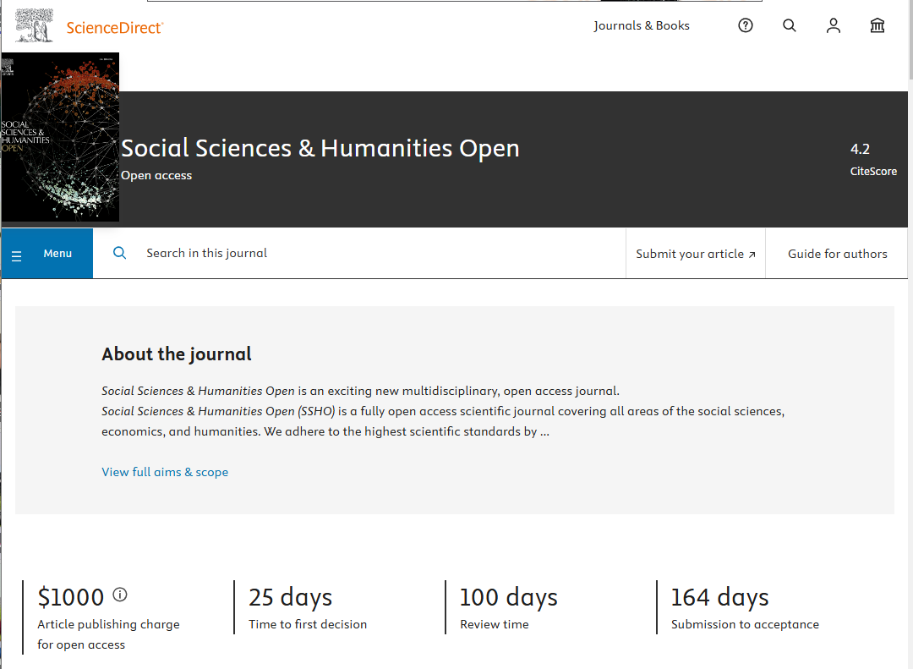
Subject Focus and Study Type Find the right journal for your research
Draw up a journal shortlist and then check the journal home page of each for:
“About the journal”
“Aims and Scope”
What types of studies what academic discipline(s) and specialisms
“Guide for Authors”
Article type (Review Articles, Short Communications,
Book Reviews, Replication Studies)
Word count(s)
Notes:
Draw up a short list, then look at each individually – aims and scope, frequency of issues, 0-OA or subscription)

Slide 9
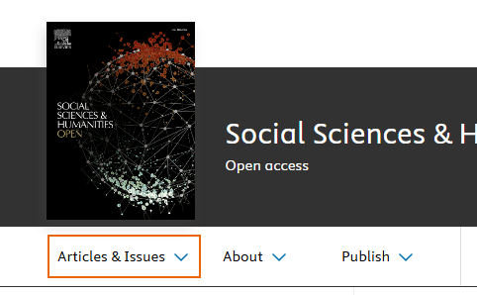
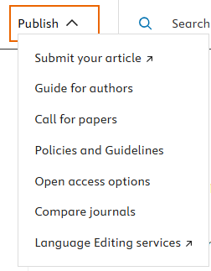
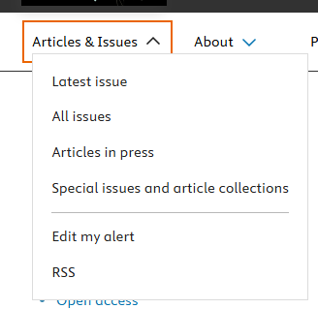
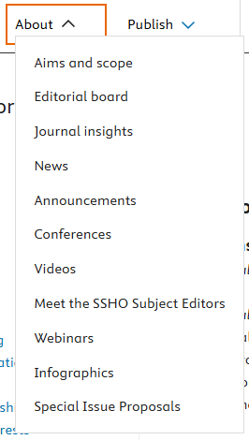
Find the right journal for your research
Editor –in-Chief (their subject specialism, institution,
areas of research focus)
Associate Editors/ Subject Editors
Editorial Board
Recent Special Issue themes and topics
Journal Rank and reputation: Cite Score, Impact
Factor
Notes:
Draw up a short list, then look at each individually – aims and scope, frequency of issues, 0-OA or subscription)

Slide 10

Metrics: Impact Factor & CiteScore
It indicates how many times the more recent manuscripts in a journal are cited on average in a given year
Indicator of where it sits in research landscape in terms of impact and subject matter (journals with high numbers of citations are considered to have a high impact within their research field)
It is influenced by Editorial policies of journals and turnover of research
The impact factor can give you a general guidance, but it should NOT be the sole reason to choose a journal
Also consider which other databases journal is indexed in
All such information is found on journal homepages
Notes:
Metrics are important for some fields and universities, not so important for others
Useful to be aware of them
As these can indicate how reputable a journal is, and where it sits in terms of the research landscape
Once you have made a short list and listed the details of each journal on it,
Rank them in order of preference, and agree with all authors which one you will submit to first
Cannot submit to more than one journal at a time
Aim high, be realistic
Again, consider any stipulations from your institute or funders with regards to metrics

Slide 11

2. Before you begin to write
Notes:
Make sure this covers:
Guide for authors
Funding
Ethical considerations – does your research involve humans?
Authorship etc.
Resources and guidance?

Slide 12
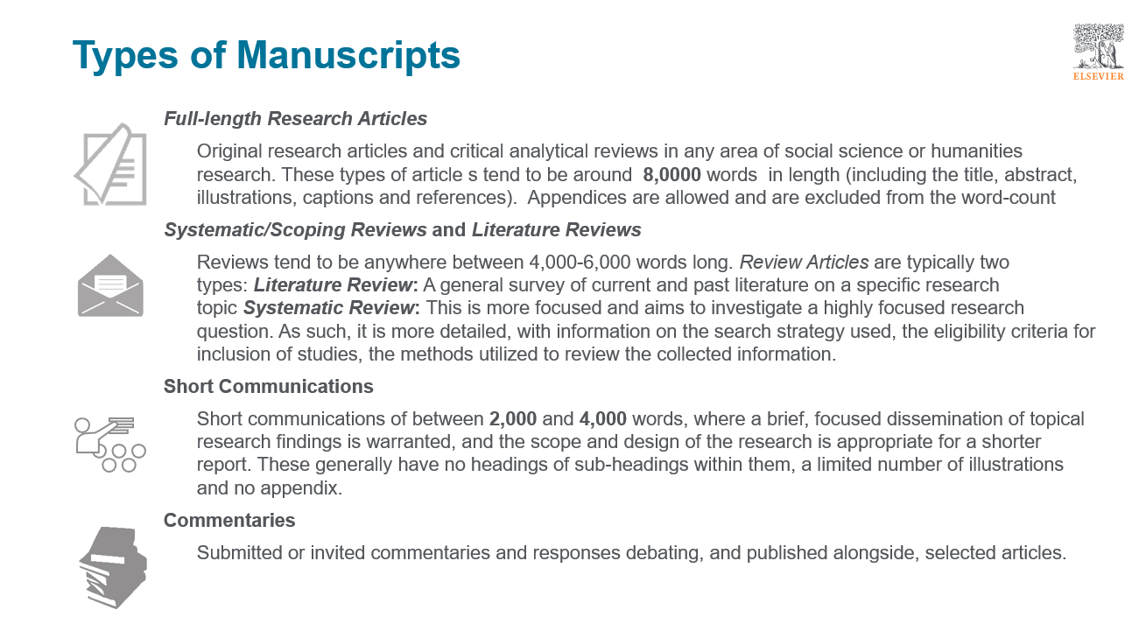
Before starting to write
1. Download and close read of Guide for Authors
Note important and specific elements
2. Decide on article type, article focus and style for your research
3. Any ethical restrictions/considerations needed to consider?
4. Decide on the list of Authors & order of Authorship – before writing
Who to be the first (lead) and corresponding Author
Authors cannot be added after submission
Order of Authorship cannot be changed during submission without good reason and clear evidence
Taking time to consider these things before writhing will save time and minimize the risk of desk rejection
Taking time to consider these things before writhing will save time and minimize the risk of desk rejection
Notes:
remember you will write for this specific journal and its audience so once again:
Check the guide for authors
Decide on angle and approach and style – aims and scope-previous articles
***click for pop up***- MANUSCRIPT TYPE

Slide 13
Before writing
Follow the journal's Guide for Authors:
Article angle? Approach? Style?
Highlights needed?
Abstract word count?
Illustrations needed? How many?
Style of referencing
Headings and sub-headers specified? Encouraged? Disallowed?
Overall length
Manuscript file to be anonymised?
Notes:
1) Check the guide for authors
Decide on angle and approach and style
Aims and scope-previous articles
Who are you writing for? And Why?
2) Length
Number of illustrations?
Referencing style?
Sub-division and headings?

Slide 14

3. Structuring your article
Notes:
Take notes from Pune (sections 3 & 4)

Slide 15
Common structure:
Page 1: Title, Abstract, Keywords
Main body text:
1. Introduction
2. Literature Review/Background
3. Methods
4. Discussion
5. Conclusion
Followed by:
References
Illustrations (if not placed within the main text)
Follow the journal's Guide for Authors for your chosen article type
Notes:
3) Common structure:
Some journals are specific about the number of headers, whether sub-headers can be used, and even the wording used; others are not.
If in doubt, check the guide and review recently published articles.
Use the structure here as a guide

Slide 16
Structuring your article
Abstract
Do not be too technical
Do not assume the reader knows all the key terms, where the study is based and so on
This should not be word-for-word the same as your Introduction opening paragraph
Literature Review
This should be comprehensive
Include all relevant literature:
Main players
Recent publications
Common debates
Notes:
Abstract
Accessible to non-specialists
International readership
Consider the scope and readership of the journal before crafting this
Separate to Introduction
Overall summary of the article
Not the same as the introduction
Should include methods, and results/Conclusion
Lit Review section
Summarise past research on the topic and relevant adjacent topics
Use own words
Cite well (inc. page numbers)

Slide 17






Structuring your article
Methods
Likewise, do not just write one or two lines
You know what you did inside out, yet we do not
Research questions
Mention these in the Introduction
Detail them one-by-one in the Methods
Address them again one-by-one in the Discussion
More writing help can be found at Elsevier’s free online tool: Researcher Academy
Notes:
Methods section
Needs to be detailed
Research should be replicable
Research aims and questions
Likewise these must be:
Clear
Mentioned in the introduction
Detail them in the methods and address the money one in the discussion

Slide 18

Importance of language
It is not only important to have a message but also to be able to successfully communicate the message
Write direct, short, and factual sentences
Convey one piece of information per sentence / avoid multiple statements in one sentence
Use active voice to shorten sentences
Avoid contractions and abbreviations where possible
Write in full paragraphs:
An ideal paragraph consists of an introductory sentence, 2–3 supporting sentences, and a concluding sentence.
The ideal length of a paragraph is 200 words and five sentences. This allows
the readers to get a good grasp of what the topic is about.
Notes:
You are in the center, but make sure the manuscript is not only written for you, but for the reader, the publisher and the Reviewers
Sentences
Write short, direct, factual sentences
Keep abbreviations to a minimum- hard t oread
Use
Paragraphs
Use full paragraphs, 3-5 sentences per paragraph
Beginning, middle and end
One point per paragraph
Proof!
Proof read, all including the references, the citations and captions for the illustrations

Slide 19

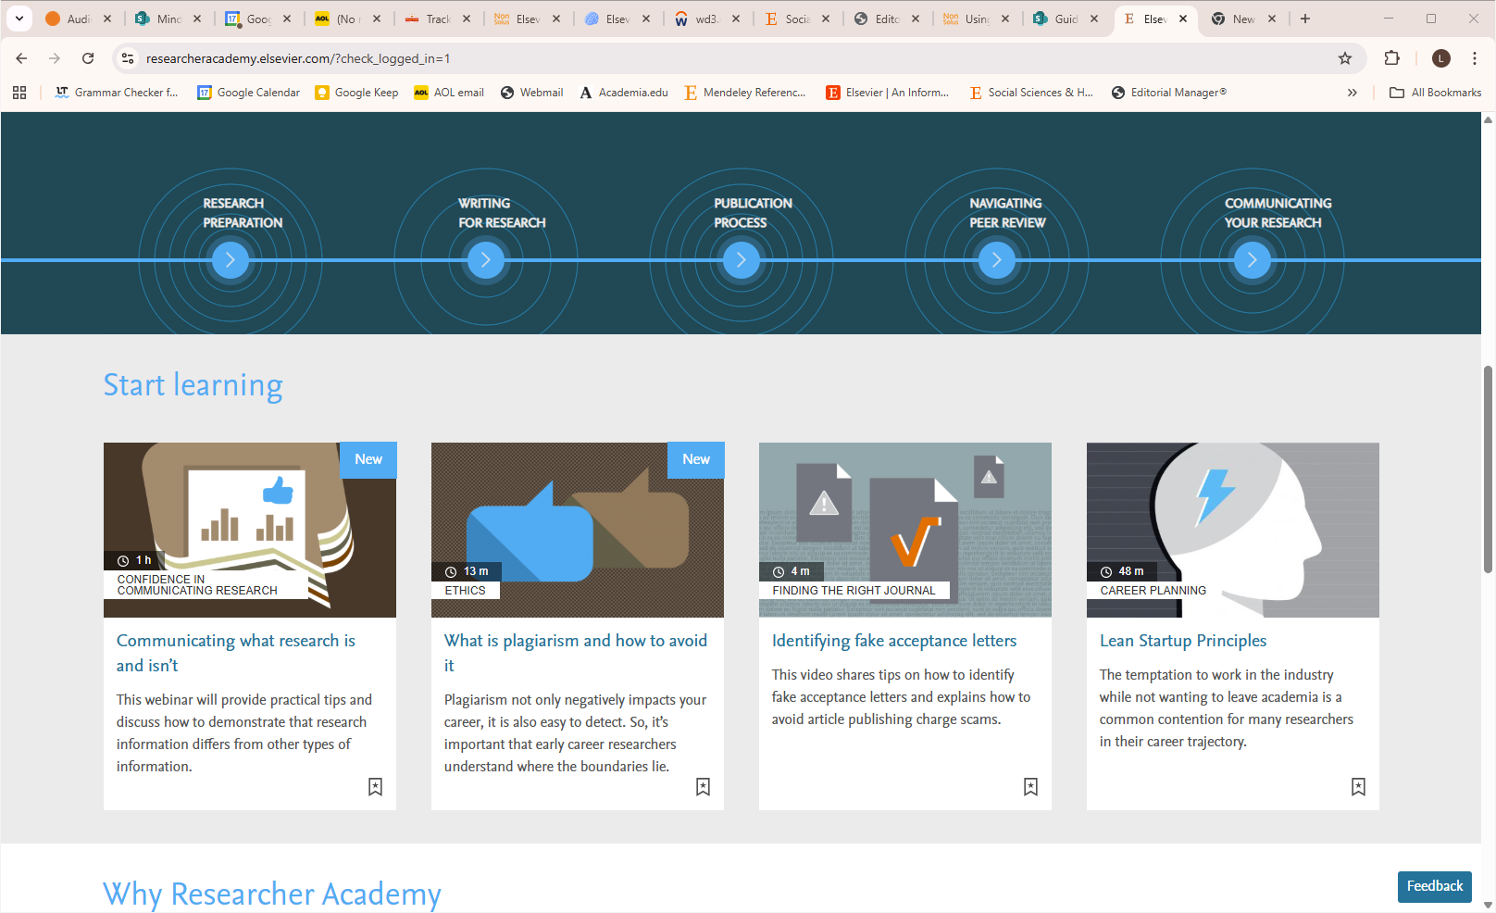
Notes:
Anyone can make a free account. There are various modules and standalone trainings on all aspects of academic research ,writing and publishing

Slide 20

Referencing
House style or Your paper your way?
Must follow one style, correctly and consistently
Use the links provided in the Guide for Author's, or go to the website of that style:
https://www.chicagomanualofstyle.org/home.html
https://apastyle.apa.org/
All sources cited should be listed in the references and vice versa
Double check and correct all citations and reference list entries if using citation software

Slide 21

Once you have an initial draft
Proofread it
Check all, including the citations, the reference list, illustrate on captions for spelling errors, correct use of grammar and typos
Check all elements once again, against the Guide for Authors
Word count
Illustrations – Clear? Captions?
Check section numbering, figure and table numbering
Ensure all reference list entries are complete and cited in-text (and vice cersa)
Share it with all Authors to give their comments – adjust accordingly
Ask your supervisor/advisor/trusted peer to look over the draft and give feedback
Ask someone from outside the research group and specialism to check it for comprehension and errors
Share with all Author’s again until the final version has everyone’s approval

Slide 22

4. Submitting your article - Editorial Manager (EM)

Slide 23
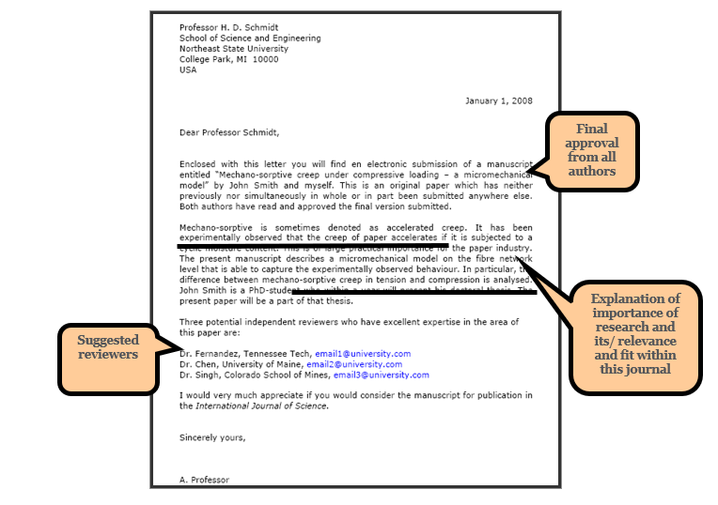
Making a submission in Editorial Manager
Allow time for this
Prepare in advance
Note the email address you use to make your Editorial Manager account with
Check the files needed from the guide for Authors “submission checklist” , and again when you make the submission i.e.
Covering Letter?
Title page file
Ethics statement?
Declaration of competing interest statement
Highlights?
Graphical abstract?
Appendices (Supplementary material)?
Notes:
(institutional is preferred and can be updated if you move)
Check which files are needed in addition to the manuscript
Stick to what is asked for - do not add in Author biographies, photo of the Authors, credit Author statement file if not asked for
All journals and publishers have different requirements do not assume that if you have published before, that you simply repeat the same steps in the same format
Supplementary material option is for appendices only -

Slide 24

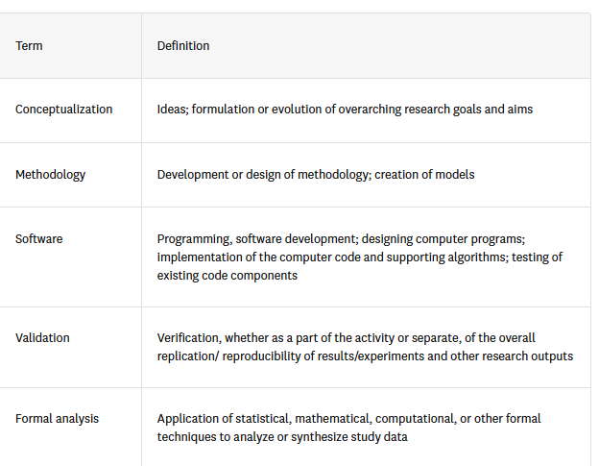
Making a submission in Editorial Manager
Ensure you have the correct, full name, title/affiliation, academic address and current (institutional) email address of all Authors
Ask each Author for this information in advance and to verify the CRediT Author roles they performed (you will entire this into a form during the submission)
Prepare a list of potential Reviewers or opposed reviewers
They must not be known to you personally
They cannot be at your institution
They should be an active researcher expert in the field
Use the resources available from Elsevier Author hub and within Editorial Manager (accessed from the journal home page “submit an article” button)

Slide 25
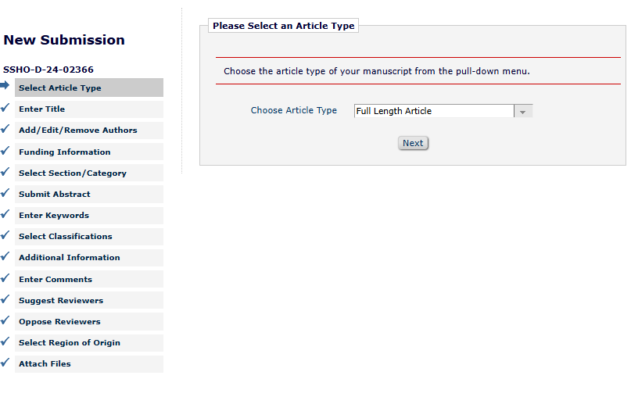
Making a submission in Editorial Manager
Read all prompts and instructions within EM carefully
Save and come back to your submission as needed, it does to need to be submitted in one go
Do download, save and check the PDF generated at the end of the submission process before finally clicking on “submit”
Share the final PDF with all Authors once the submission had been made

Slide 26
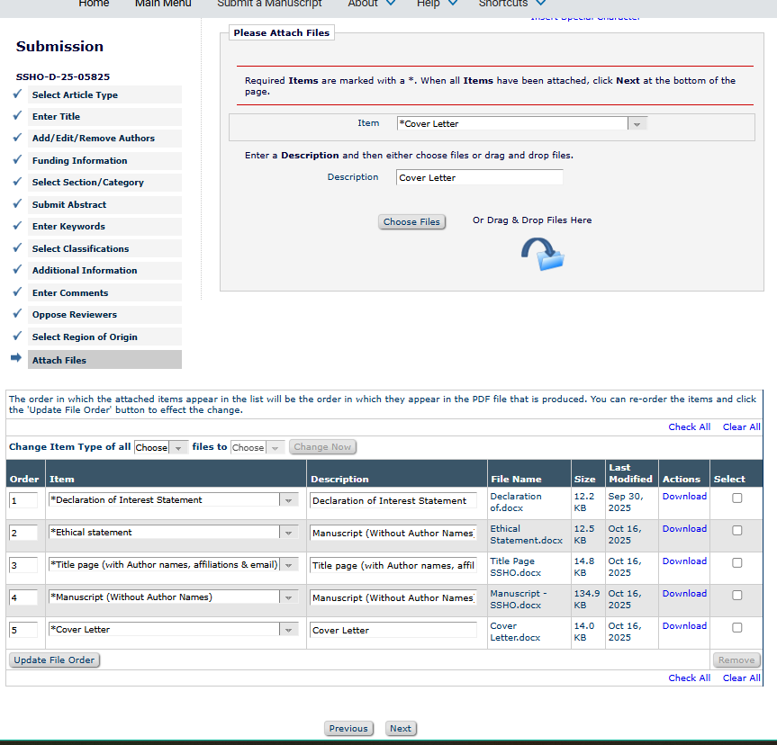
Making a submission in Editorial Manager
Read all prompts and instructions within EM carefully
Save and come back to your submission as needed, it does to need to be submitted in one go
Do download, save and check the PDF generated at the end of the submission process before finally clicking on “submit”
Share the final PDF with all Authors once the submission had been made

Slide 27


5. Common mistakes
…or How to Avoid Desk Rejection
Notes:
Be sure to cover
Bad choice of title
Inappropriate keywords
Not reading the guide for authors
Nor correctly preparing the files for submission
Reference list and citations
Not allowing enough time for submission – save and come back to it
Illustrations -numbering and captions
Charts and graphs
Maps

Slide 28
Common reasons for (desk) rejection
“Manuscript (without author names)” file not anonymous
Word count
Plagiarism and incorrect citation practices
Article type selected not matching the content submitted
Ethics statement and IRB approval
Missing or incorrect declarations:
Funding Statement
Declaration of the use of AI
Data availability statement
Acknowledgements
Conflict of interest statement
Incorrect, inconsistent or incomplete authorship information
Always check your files carefully, before and during submission, to ensure you do not get desk rejected because of these basic errors
Notes:
These common elements are easily avoidable:
Go over, one by one

Slide 29

Other common mistakes
Place importance on the title, abstract and keywords
In the writing
Incomprehensible title and/or abstract
Title/abstract full of abbreviations
Trying to do too many things in one article
Failure to state the research aims and contribution clearly
Having a poor discussion that essentially repeats the findings; or no discussion at all
Lacking a Conclusion or Literature review section
The title, abstract and keywords are critical for Editors, Reviewers and readers
A good title should contain the fewest possible words that adequately describe the contents of an article – it is what makes us want to read the article (or not!)
A clear abstract will strongly influence if your work is considered further - tell readers what you did, why you did it, and the important findings
In an electronic world, keywords determine whether your article is found or not!
Poor presentation:
Inconsistent section headers and sub-headers
Lack of line space between sections and illustrations
Lack of proof reading:
Table and figure numbering errors
Unclear illustrations
Spelling and grammatical mistakes
Notes:
Writing
The style is important –
Esp the title, the abstract [CLICK]
Explain the details
These are:
Important elements
Key for finding reviewers
[CLICK]
Covering too many things too sparsely
Research questions and aims unclear
The structure -no intro, no conclusion or no discussion
Presentation
Needs to be clear, lime spacing, blurred illustrations, too much in bullet points
Errors in formatting:
Font changes mid ay, section numbering incorrect
Two figures with the same number of missing captions altogether

Slide 30

6. Ethical considerations
Notes:
Studies involving people
Ethics statement (IRB certification/exemption)
Plagiarism
Responsible AI Use

Slide 31
Authorship
An “Author” is generally considered to be someone who has made substantial intellectual contributions to a published study.
The Author list and the order of Authors should NOT be changed once the manuscript is submitted
Dos
First Author
Conducts and/or supervises the data generation and analysis and the proper presentation and interpretation of the results
Performs the bulk of the writing and organises the team
If the article is based on a PhD thesis, the Author of the thesis must be the first Author
Corresponding Author
This should be the first Author or a more senior Author (with permanent contract)
Particularly when the first Author is a PhD or postdoc (will move to another institution and change email address)
Don’ts
Ghost Authorship
Leaving out Authors who should be included
Gift Authorship
Including Authors who did not contribute significantly
Change authors
Add in or remove authors once in manuscript is sent to review
Notes:
Who can and should be named as an author ?
be someone who has made substantial intellectual contributions to a published study.
Not a proof reader, not someone who made the map or illustrations
[CLICK]
Should be listed in order of contribution
- first author did the bulk of the work
Cannot be 2 first authors
PhD work- then thesis writer is first author – no debate
[CLICK]
Corresponding author:
Named person we and the academic community communicate with
The spokesperson of the work
Can be any of the authors
Cannot be two corresponding authors
[CLICK]
Donts:
See slide
Not someone who leant you resources or let you use their lap
substantial intellectual contributions

Slide 32
Avoiding plagiarism
All manuscripts are checked for this
Your work will desk rejected if this is found
There are many sources which explain:
What plagiarism is
That explain how to cite, how to reference
Please consult these
When you research and take notes use quotation marks or your own words
Always write the full source details, including page number next to the notes
What is plagiarism? How to avoid it
7 ways to avoid academic plagiarism
APA guide to avoiding plagiarism
Notes:
“Plagiarism is the act of presenting the words, ideas, or images of another as your own; it denies authors or creators of content the credit they are due. Whether deliberate or unintentional, plagiarism violates ethical standards in scholarship “

Slide 33
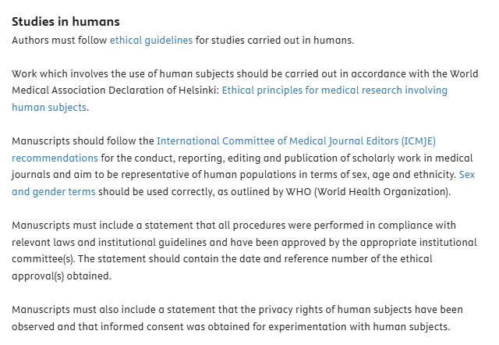
Studies involving people:
Including but not limited to:
Need approval from or to have been exempted from needing approval, by institutional review board before research is carried out
Participants need to have been informed the purpose of the research, their rights, and to have consented to participate
Always check with your institution, and national and international guidelines before beginning any study involving people (or animals)
Ethnographic studies
Interviews
Observations
Questionaries
https://www.sciencedirect.com/journal/social-sciences-and-humanities-open/publish/guide-for-authors
Notes:
Many journals will require an ethics statement from ALL submissions
• And if your research has involved the study of or involvement of participants in any way, there are certain ethics considerations you should have followed:
This includes interview, ethnographic studies, questionnaires filled in online
[CLICK] o If this is the case, always check the journal’s policy and guide for authors for details before beginning your research.
o In general:
Even if you have undertaken a desk-based study, or a study not involving people in anyway, check the journals policy, and prompts within Editorial Manager and follow the instructions
I.e. SSHO asks for all to upload a file called ethics statement, and to write “An ethics statement is not applicable for this manuscript” if that is the case

Slide 34
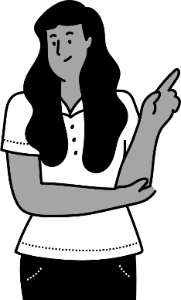
Responsible use of AI
What is Generative AI?
GenAI is an umbrella term for learning algorithms that make predictions and that can produce new content based on a given input (prompt).
Generative AI can use that same data to create something new.
Text and images can be generated, and the result is often indistinguishable from human text
Input:
Prompt
Output:
Text, code, image, audio
LLM
Notes:
So, let’s start at the beginning with a recap on what Generative AI is. Generative AI, or GenAI, refers to learning algorithms that make predictions and that can generate new content if you feed it input, also known as a prompt.
An LLM predicts the likelihood of a word given the previous words in a text, and then generates new text that is often indistinguishable from human text and can sound very authoritative. But the model can generate output that is incorrect, incomplete, or biased. And that’s the reason that it’s essential that this powerful and exciting technology is applied with human oversight and control.
Just a few words on using LLMs. It’s important to put some thought into selecting the right model for your task and providing the model with a good prompt, because that will influence the quality of the output. A good prompt will typically provide the model with a role or identity, a context, a query or a task, a desired output format, and if possible, an example.
As you’re using such a tool it’s also important to set the temperature of the model. This is usually a lever between 0 and 1. A low temperature will make the output more factual and deterministic, while a higher temperature will result in the output becoming more creative.

Slide 35

Why should we think about GenAI in the context of scientific writing and publishing?
Many researchers have questions about the technology, and how it should and shouldn’t be used in the context of scientific publishing.
There are concerns about inaccuracy, unreliable references, copyright infringement and training bias.
Am I allowed to use this technology?
How do I disclose it?
Should I list an AI-system as a co-author?
Notes:
AI is becoming part of many aspects of life, including research and academia
Authors are using it in their work and so we need to be aware of the negative sides, and also author responsibility when it comes to AU
There are many concerns about the technology (see slide)
And researchers often have questions such as:
[CLICK] “Am I allowed to use AI to research, or to write my article?”
[CLICK] “How do I disclose AI use?”
[CLICK] “Should I lost AI as a co-author on my paper?”

Slide 36

Elsevier Responsible AI Principles
Elsevier’s policy states that authors should:
Only use Generative AI and AI-assisted technologies to improve readability and language of the work.
Apply the technology with human oversight and control, as it can generate authoritative-sounding text that may be biased, incorrect, or incomplete.
Disclose in their manuscript the use of Generative AI and AI-assisted technologies.
Author's must not:
List Generative AI and AI-assisted technologies as an author or co-author or cite AI as an author.
Use generative AI or AI-assisted tools to create or alter images in submitted manuscripts
Exception: Where the use of Generative AI or AI-assisted tools is part of the research design or research methods (such as in AI-assisted imaging approaches to generate or interpret the underlying research data), such use must be described in a reproducible manner in the methods section.
Elsevier's full “Responsible AI Principles” and policy can be found here
Notes:
Our own policies on GenAI that we developed and launched in 2023 are broadly aligned with other industry stakeholders.
The author policy refers to the use of GenAI in the writing process, and not to the use of AI as part of the research process.
It states that authors should:
Only use GenAI to improve language and readability,
Apply it with human oversight and control,
Disclose the use of GenAI in the paper, and
Not list GenAI as a co-author or cite it as an author.
The policy for reviewers and editors focuses on protecting the author’s rights and keeping the manuscript confidential. So, critically, reviewers and editors should:
Not upload the manuscript into an AI tool
And the same goes for other documents that may contain information about the paper, including the peer review report and any editorial notification letters.
Lastly, we don’t currently allow GenAI to be used by reviewers or editors in the review, evaluation, or decision-making process of the paper. We are actively evaluating and exploring compliant tools that enable safe and secure use, and we may revise this policy in the future.
We also have a policy for the use of GenAI in artwork, which states that:
We don’t allow the use of GenAI to create or alter images in submitted manuscripts
The only exception is when AI is used as part of the research process, as is the case in certain research fields such as biomedical imaging, and in those cases we require a full disclosure.
The use of GenAI is not permitted in the production of artwork, but in some cases it may be allowed for journal covers.
You can find all the details of the policies on our publishing ethics page.

Slide 37

7. The submission journey
Notes:
Moving onto the last section now, the submission journal, understanding the assessment , peer review and revisions process

Slide 38
Submit manuscript to Journal
Desk Reject
Sent to specialist Editor for assessment & peer review
Screened by Editorial Team
Returned for minor improvements
Reviewers’
Comments
Major/Minor Revisions
Reject
Editorial Decision
Accept
Notes:
Explain the chart

Slide 39
First Decision: Major/Minor Revisions
The manuscript may eventually be published in the journal, but changes are needed:
Changes may be major, requiring additional analysis, review of literature or significant modification of text or restructuring
Or may be more minor, requiring clarification or smaller text changes
Typically, it means the Editor sees merit in your work (which is a positive thing!)
“Revision” does not guarantee acceptance after revision, but often the article is (eventually) accepted after 2 or more revision rounds
Notes:
Almost all published articles go though various rounds of revisions

Slide 40

Manuscript Revision
Carefully study the Reviewer’s comments and any made by the Editor
Adjust your manuscript and prepare a detailed letter of response (share with all Authors)
Prepare a detailed Response to Reviewers' Letter
Copy-paste each Reviewer comment, stating the reviewer number and the comment number
Type your response below it
State specifically which changes you have made to the manuscript
Include page/line numbers
Tell them how they can find the response on the manuscript file (colour or the highlights used for example)
Provide a scientific response to all comments, even those you disagree with stating you:
Accept and have made the changes
Or provide a convincing, solid and professional rebuttal when you feel the Reviewer was wrong.
Write in such a manner, that your response can be forwarded to the Reviewer without prior editing
Professional, addressed to each Reviewer in turn
This letter and the manuscript file must remain anonymous
Notes:
Proof read all files carefully again.
Check the letter from the Editor, what is needed with the resubmit Tion – a new covering letter? Draft this in advance also and add in any comments you have for the Editor specifically

Slide 41


Final Editorial decision
Accept
Receive proofs
Correct the proofs
Add in anonymised information:
Self-citations
Acknowledgements
Funding statement
Provide better quality illustrations
Reject
Common
40-80% of all submissions, depending on the journal
Do not despair!
Notes:
You are in the center, but make sure the article is not only written for you, but for the reader, the publisher and the Reviewers

Slide 42

Do not despair
Rejection happens to all of us, but it is the exception that the work is really unpublishable
Even desk rejections can be improved and eventually published
Try to understand why
Read the information in the rejection email carefully, allow a few days to calm down and accept the decision
Consider Reviewers’ advice
Be self-critical
Do not dismiss the Reviewer’s comments out of frustration, anger or pride
Even if they misunderstood something, this is likely to be in part because you have not explained something well enough or omitted vital contextual information
Discuss the rejection comments with colleges and peers
Do you need to make major changes (collect more data, change the methodology)
Or is the work needed more down to improving the style flow and structure?
Notes:
Click for animation

Slide 43
Questions?
Thank you!

Slide 44
Useful Resources

Slide 45
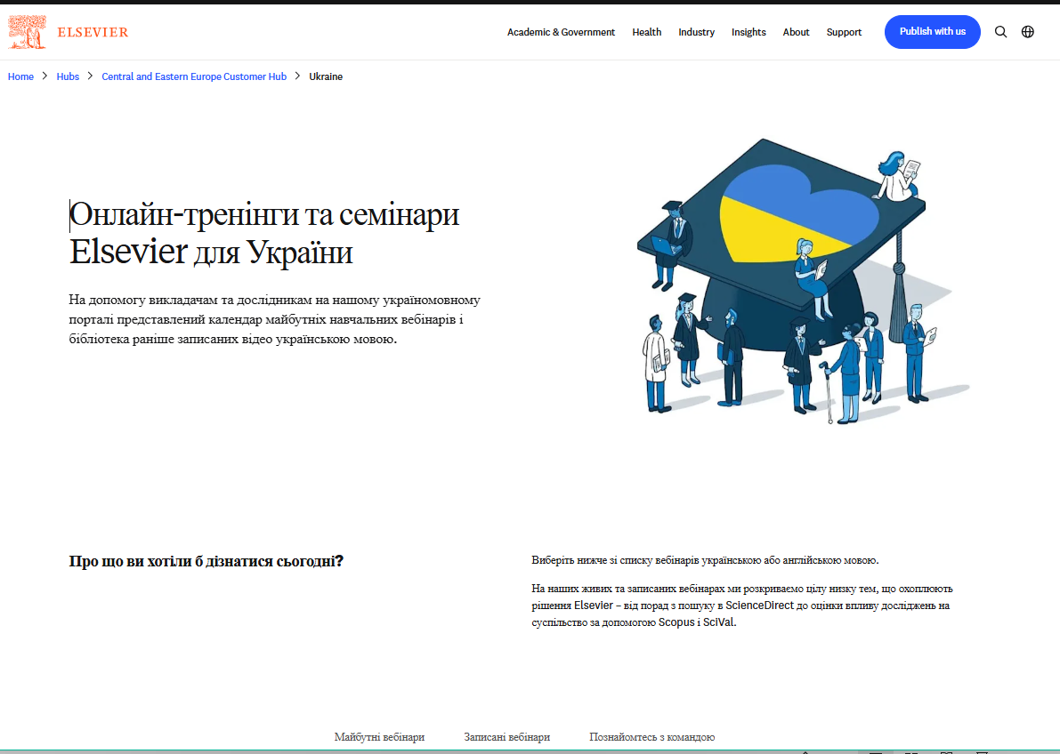
Ukraine Academic Support Supporting Ukrainian academics, researchers, and students
-Complimentary access
-Researcher Academy and Mendeley
-APC waivers
Please see: Cемінари Elsevier для України
Notes:
Ukraine Scheme help and links

Slide 46
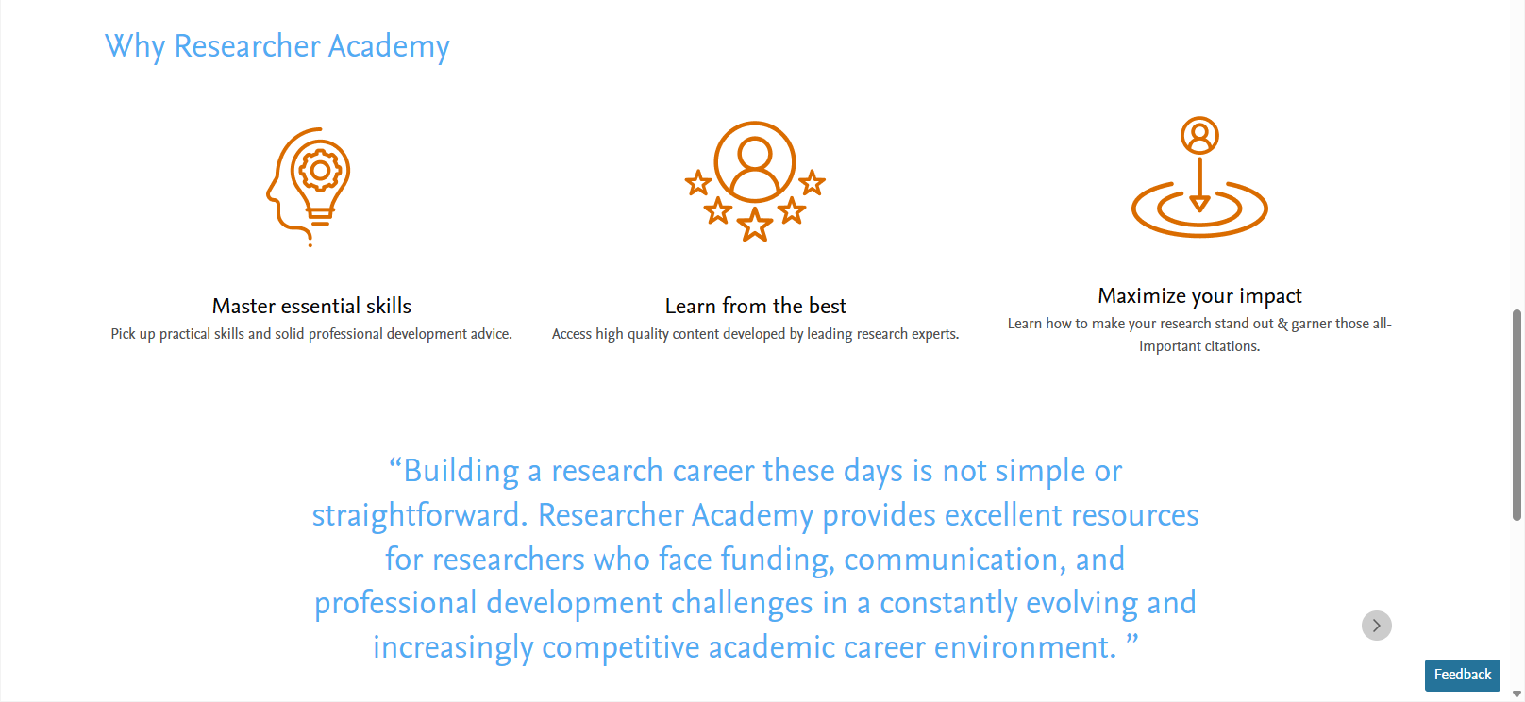
Elsevier Researcher Academy
Elsevier Researcher Academy - free to access
https://researcheracademy.elsevier.com/writing-research/writing-skills
https://researcheracademy.elsevier.com/publication-process/finding-right-journal
https://researcheracademy.elsevier.com/writing-research/fundamentals-manuscript-preparation
Notes:
Researcher Academy – introduce

Slide 47
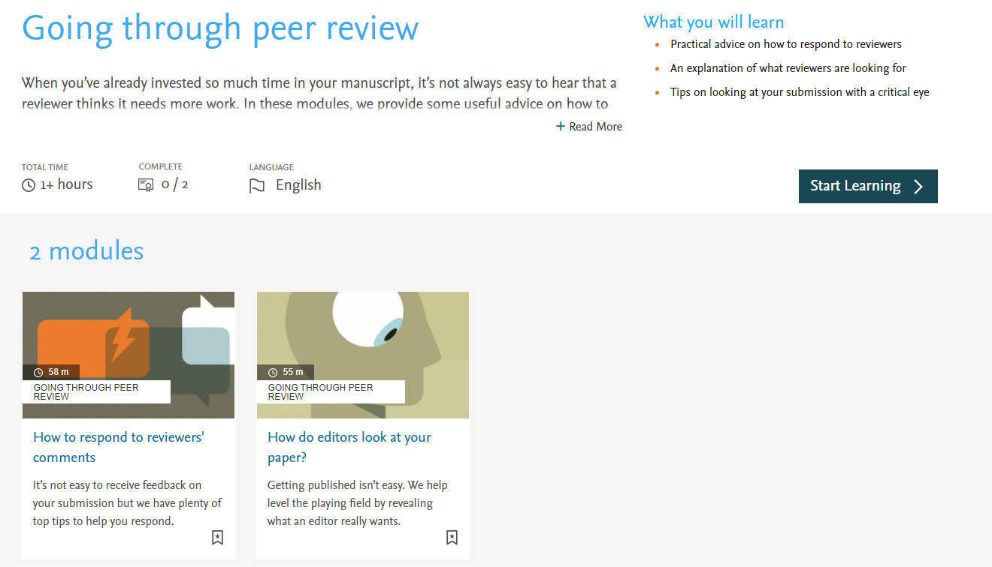

If you would like to learn more about peer review:
Elsevier Researcher Academy - Going Through Peer Review
Notes:
Sections not only on writing and submitting, but the peer review process also

Slide 48
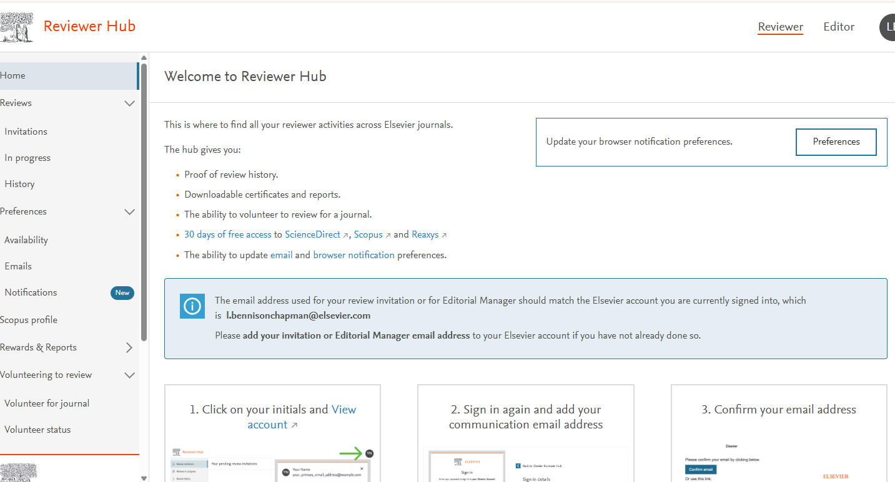
Would you like to review manuscripts?
https://Reviewerhub.elsevier.com/Reviewer/volunteer/journal
Notes:
You can also register to be a reviewer for Elsevier journals

Slide 49

Other APC discount and waiver schemes
Research 4 Life
Institutions in Low- and Middle-Income countries can obtain free access to books and journals
Reduced APC on many Elsevier titles for eligible submissions:
https://www.research4life.org/
Geographical Pricing
Elsevier is piloting a program from January 2024 to set APC prices for 143 gold open access journals according to the income level (countries as classified by the World Bank as of July 2025) of the country the corresponding Author is working/living in:
For the pilot journals the APC will be:
Low-income countries - APC waived
Lower-middle income -APC is 20% of list price
countries
Other countries -APC 45-90% list price
.
https://www.elsevier.com/about/policies-and-standards/pricing
Notes:
As well as offering discounted or waived APCs, Research 4 Life also gives free access to Institutions in Low and Middle income countries to books and journals content.

